Slide 1
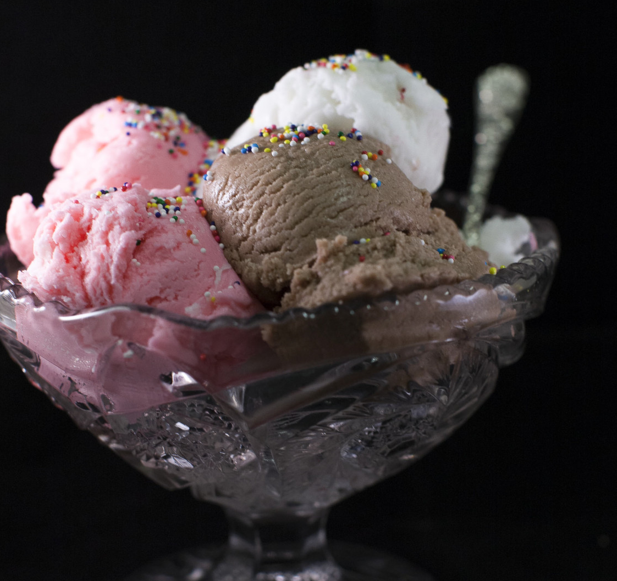
Ice Cream Social
Taft College’s ASO invites you to join us on Thursday August 7th between 5pm and 6:30 pm in the Student Center for a fresh start to the new school year. Students who present the yellow ASO sticker for the 2025 to 2026 school year will receive free ice cream! We hope to see you there.

