Slide 1

STUDENT SERVICES UPDATES
Spring 2023
Dr. Damon A. Bell
Vice President, Student Services

Slide 2
Student Services Organizational Changes
VPSS Dean
Dean, Student Services Student Life and Basic Needs
Student Housing DSPS
Financial Aid EOPS/CARE/CalWORKs
Admissions and Records Outreach
Athletics Counseling and Advising
TIL Mental Health Services
Student Conduct/Title IX VRC

Slide 3
Dean of Student services office
Cecilia Alvarado
Dean of Student Services

Slide 4
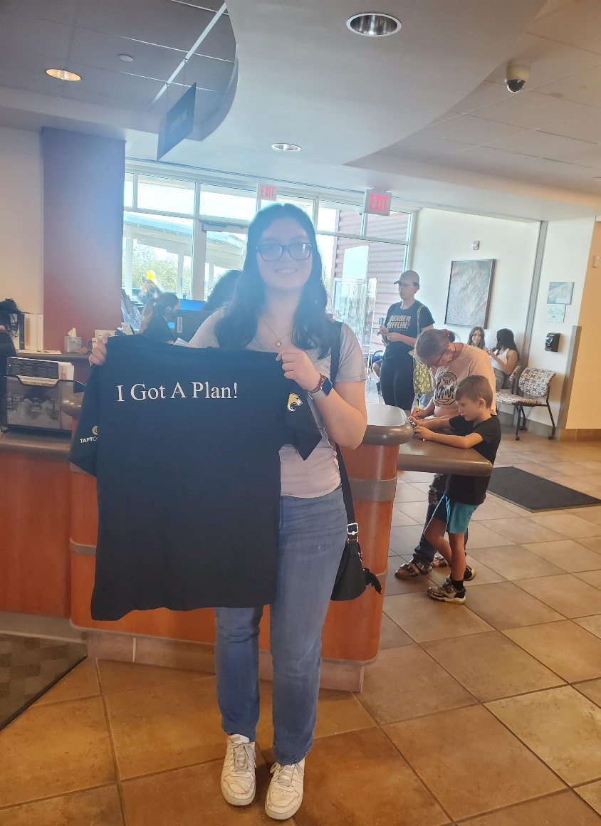
Counseling & Retention
Fall 2022:
Counseling Campaign that includes:
  Ed Plan are at over 95% complete
  Student Milestone are one counseling appointment per semester.
  “ I got a plan t shirt and a TC resources binder”
  Every students receives a follow up phone call and email
  Every students received a “ please register for your class” reminder”
Spring 2023
  Continue with the Counseling Campaign
  Add April and May High School Cougar Days that include an ed plan and registration in one day.

Slide 5

New: Building Community & Celebrate the Student Week
Student Services hosted:
TC open house that included a resource fair, food, Cougie, free t-shirts
hosted a donut day for student workers to show appreciation for their hard
supported a student Lunch with the president.
Promoted a “Celebrate the Student Week”

Slide 6
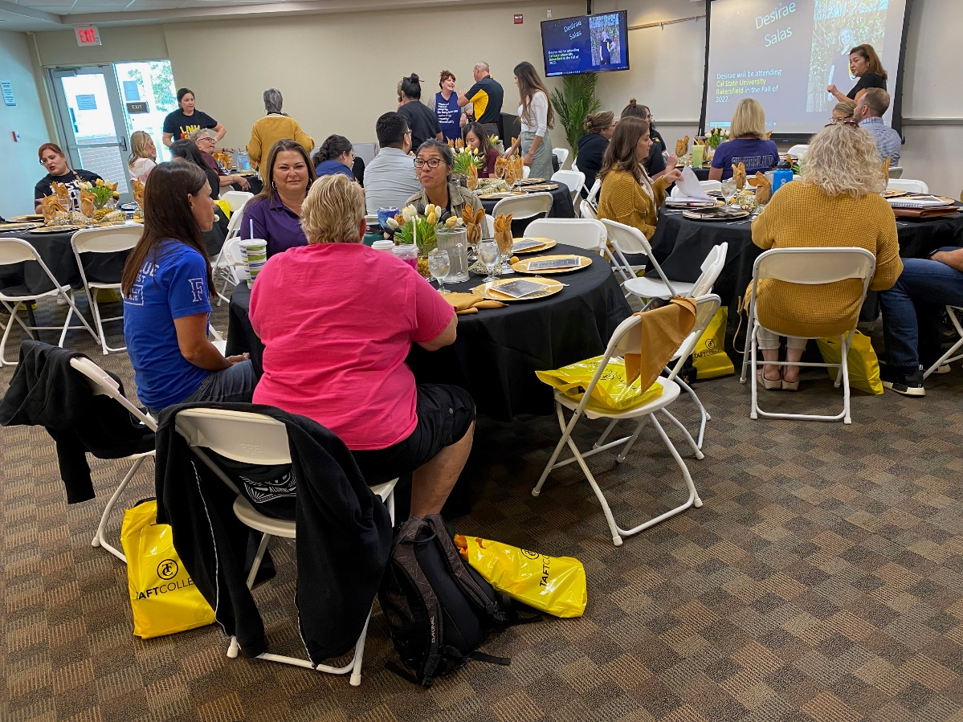
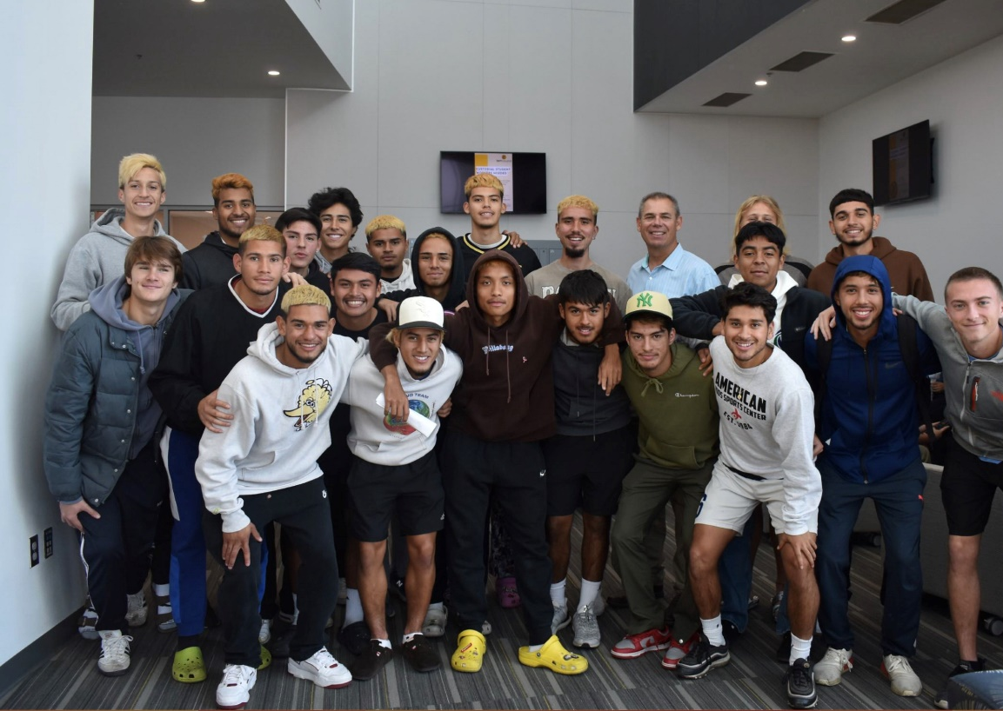
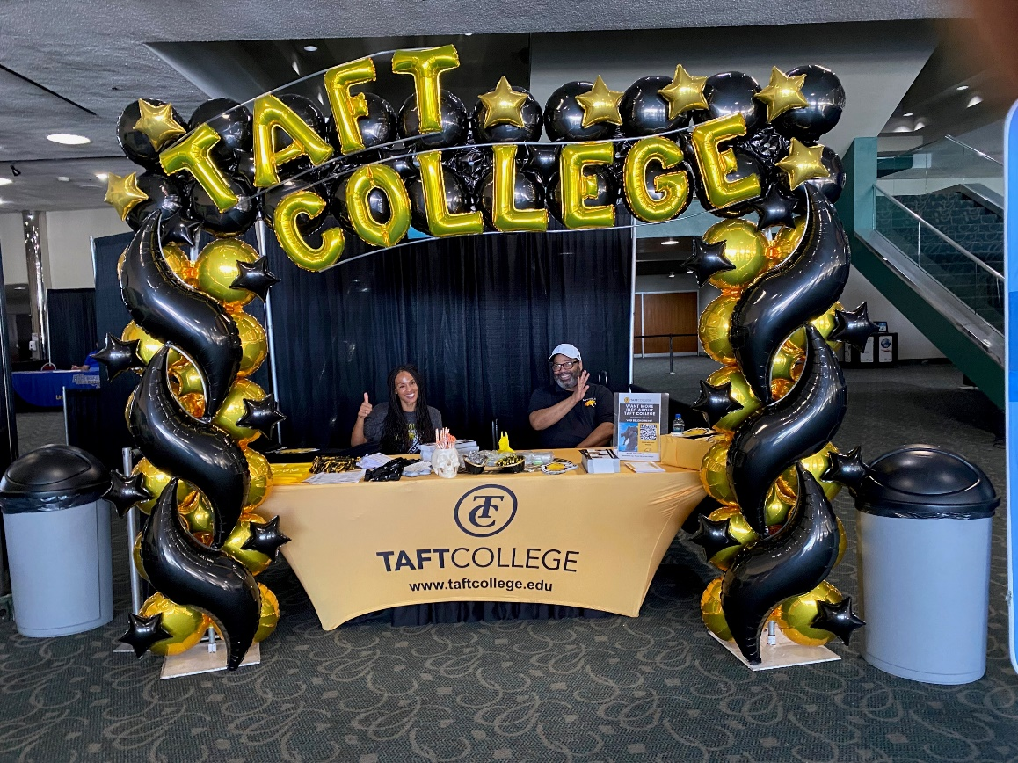
Fall 2023 Outreach:
Hire a full time Outreach Director
Host TC application workshops at local high schools in early Spring.
Coordinate Cougar Days to be held at TC or at a H.S in late Spring.

Slide 7
FINANCIAL AID & SCHOLARSHIPS
Barbara Amerio
Director of Financial Aid & Scholarships

Slide 8
student Housing
Angelo Cutrona
Dorm Supervisor

Slide 9
Spring updates
Staff
Angelo Cutrona, Dorm Supervisor
John Delaney, On-Campus Resident Advisor for the Ash Dorms
Steven Bogden, On-Campus Resident Advisor for the Cougar Dorms
Enrollment
  30 students checked out of the dorms at the end of fall 2022
  18 new spring applications
  13 of the 18 have confirmed
  *** No more covid rooms***
  Space is available in the TIL dorms and Ash Dorms for students looking to live on campus or for emergency housing

Slide 10
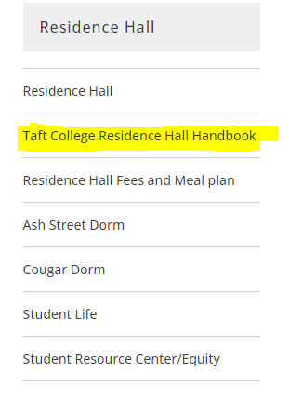
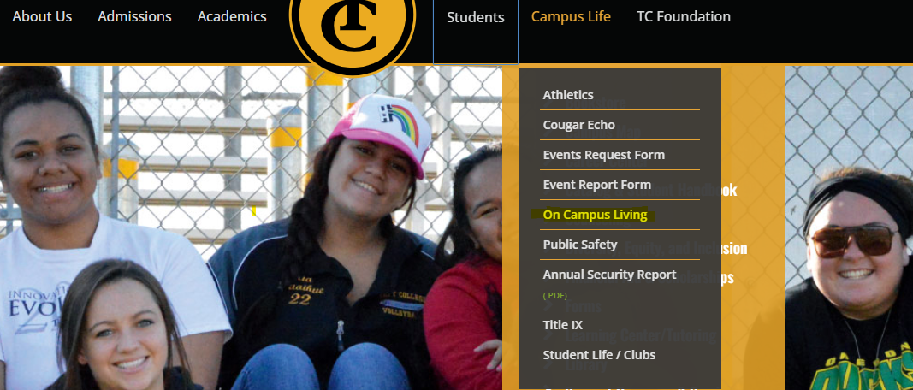
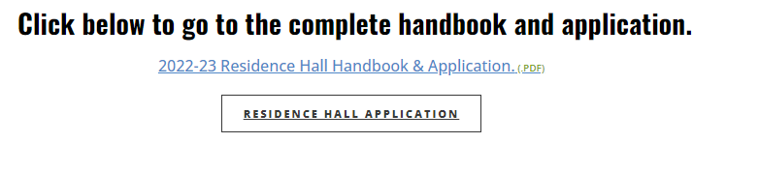
How to get to the dorm application
2
1
3

Slide 11
STUDENT LIFE AND
BASIC NEEDS
Myisha Cutrona
Coordinator of Student Life and Basic Needs

Slide 12


COUGAR SUPPORT CENTER
Cougar Support Center Coordinator
Diana Ramirez
This Week:
10 am – 2 pm
SPRING HOURS
Monday – Thursday 8 am – 4 pm
Friday 8 am – 2 pm
Food/Clothing Donations
Fridays before 1 pm

Slide 13
Student Life Campus Clubs & Advisors
ASO – Myisha Cutrona
Best Buddies – Patricia Owen
Dental Hygiene – Christi Adriano
Early Care and Education – Michele Beasley
InterVarsity – Shelley Getty
Multicultural – Cecilia Alvarado
National Society of Leadership and Success – Myisha Cutrona
Performing Arts – Leigh Golling
Phi Theta Kappa – Sharyn Eveland
Social Science Research Group – Michelle Oja
SPECTRUM – Darcy Bogle
STEM – James May
Veterans – Tina Mendoza
Wellness – Rebecca Roth

Slide 14
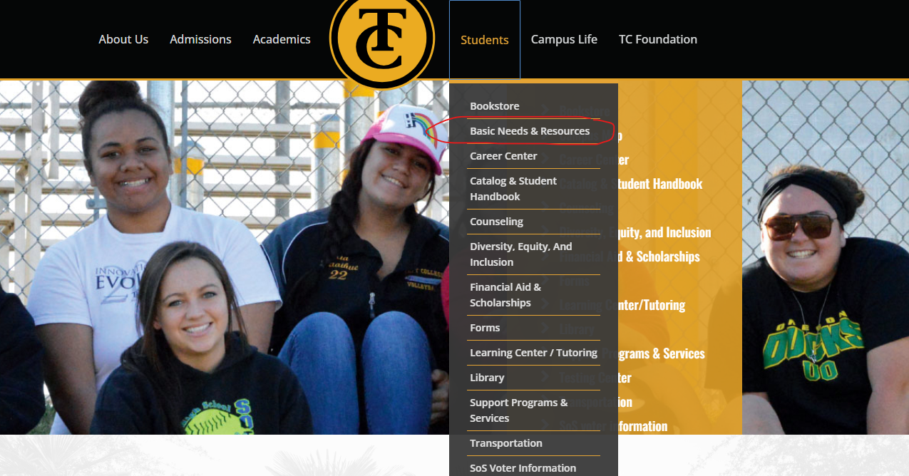
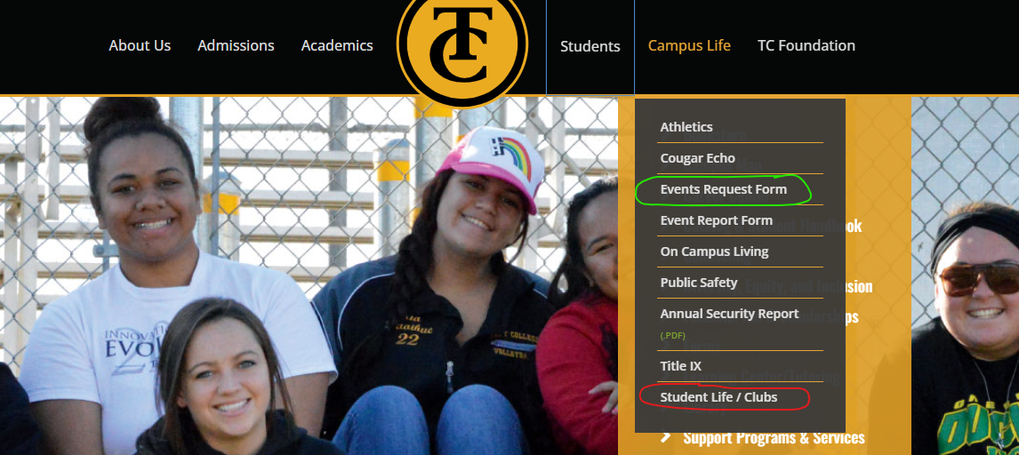
Upcoming Events/Activities
Where to find the programs on the current website
January
Cougar Support Center Word of Mouth Challenge
Welcome Back Student Luncheon and Outreach – 18th
Student Job Fair – 23rd & 24th
^{Later This Semester}
^{Cal Fresh Tour}
Student Senate General Assembly
Community Job Fair sponsored by Kern County Human Resources

Slide 15
Athletics
Kanoe Bandy
Athletic Director

Slide 16
Transition to Independent Living Program
Aaron Markovits
Director of the TIL Program

Slide 17
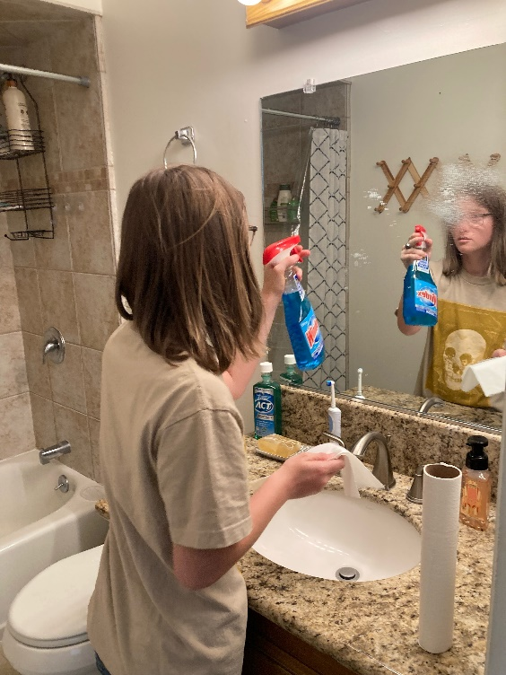
Transition to Independent Living
This year will be the 25th graduating class for the TIL Program
29 students enrolled in the program. 11 freshman on campus 11 Sophomores off campus, 7 3rd year students off campus.
Using a Person Centered Approach: students take classes from Taft College and training from West Kern Adult Education Network.
All students required to take Surviving College (STSU 1016) and Career Exploration (STSU 1018)
Freshman students are required to take classes to earn a Management-Customer Service: Certificate.

Slide 18
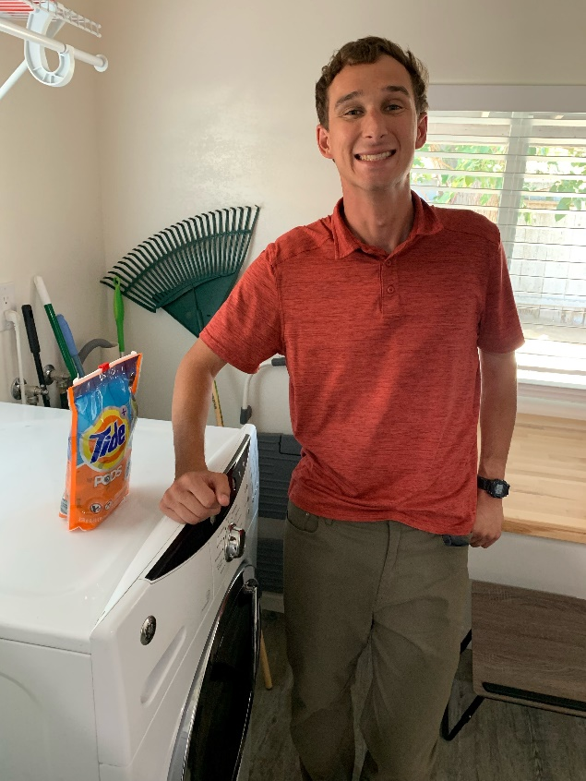
TIL Cont’d
Students have a diagnosis of Intellectual/Developmental Disabilities and qualify for Regional Center Services.
Serve students from throughout the State of California.
Internationally Recognized as a Promising Practice by Zero Project in 2020.
One of 22 model demonstration Transition and Postsecondary Programs for Students with Intellectual Disabilities (TPSID) in the Country. The only program located on a community college campus.
July 2023 Taft College will begin a Workability III program, which will assist students with disabilities with vocational training and employment.
Students receive instruction in independent living, education, social and vocational skills.

Slide 19
ADMISSIONS
AND RECORDS
Tiffany Payne
Interim Director of Admissions and Records

Slide 20
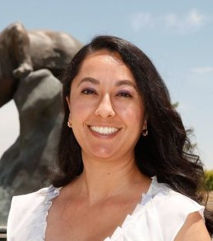
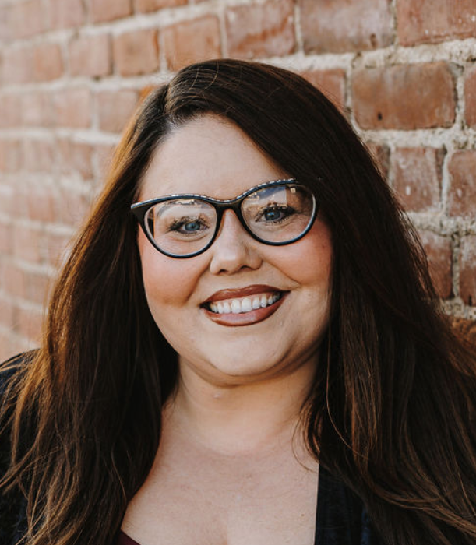
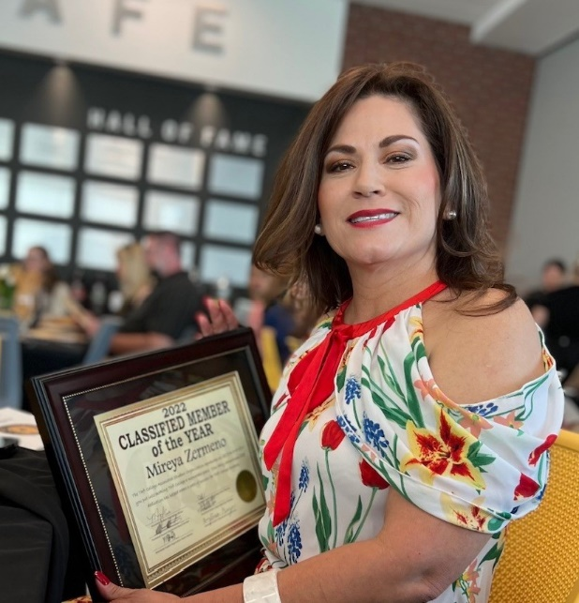
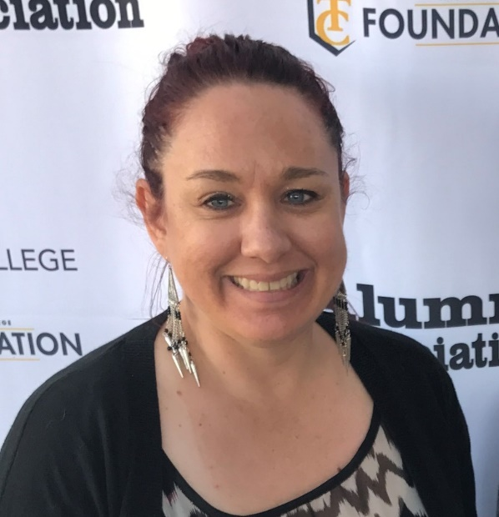
Admissions and records team members
Isaura (Izzy) Santiesteban
Admissions and Counseling Center Technician
Tiffany Payne
Director of Admissions and Records
Mireya Zermeno
Admissions and Records Technician I
Lisa Brettschneider
Admissions and Records Technician II
Vacancies: Admissions and Records Technician II (currently hiring), Evaluator (job will be advertised soon)

Slide 21
Who to contact when you need assistance
Academic Policies and Procedures Committee records@taftcollege.edu Call: Records (ext. 7756)
Add Class Registration Form admissions@taftcollege.edu Call: Admissions (ext. 7741)
Add Codes/Waitlists tipayne@taftcollege.edu Call: Tiffany (ext. 7870)
Admissions and Attendance Committee admissions@taftcollege.edu Call Primary Lead: Mireya (ext. 7790)
Audit Class Registration Form counseling@taftcollege.edu Call: Counseling (ext. 7748)
Catalog Changes/Corrections tipayne@taftcollege.edu Call: Tiffany (ext. 7870)
Census Rosters/Arranged Hours records@taftcollege.edu Call : Tiffany (ext. 7870) until new employee is hired
Change of Grade Form records@taftcollege.edu Call: Records (ext. 7756)
Credit by Exam records@taftcollege.edu Call: Records (ext. 7756)
Credit for Prior Learning records@taftcollege.edu Call Evaluator: Tiffany (ext. 7870) until new employee is hired
Drop Class Registration Form admissions@taftcollege.edu Call: Admissions (ext. 7741)
Grade Submissions tipayne@taftcollege.edu Call: Tiffany (ext. 7870)
Graduation Applications tcgradapps@taftcollege.edu Call: Records (ext. 7756)
High School Special Admits admissions@taftcollege.edu Call Primary Lead: Mireya (ext. 7790)
Incomplete Grade Form records@taftcollege.edu Call: Records (ext. 7756)
International Students admissions@taftcollege.edu Call Primary Lead: Izzy (ext. 7798)
Petition Academic Renewal records@taftcollege.edu Call Evaluator: Tiffany (ext. 7870) until new employee is hired
Petition for Substitution records@taftcollege.edu Call Evaluator: Tiffany (ext. 7870) until new employee is hired
Petition to Withdraw records@taftcollege.edu Call Evaluator: Tiffany (ext. 7870) until new employee is hired
Program Requirement Questions records@taftcollege.edu Call Evaluator: Tiffany (ext. 7870) until new employee is hired
Repeat Petition records@taftcollege.edu Call Evaluator: Tiffany (ext. 7870) until new employee is hired
Request for Pass/No Pass Grading records@taftcollege.edu Call: Records (ext. 7756)
TC Transcripts records@taftcollege.edu Call: Records (ext. 7756)
Transcripts from other institutions (equivalency, credit, etc) records@taftcollege.edu Call Primary Lead: Izzy (ext. 7798)
Veterans veterans@taftcollege.edu Call Primary Lead: Lisa (ext. 7916)
Dismissal Appeal admissions@taftcollege.edu Call Primary Lead: Mireya (ext. 7790)
Loss of CCPG/Enrollment Priority Appeal admissions@taftcollege.edu Call Primary Lead: Mireya (ext. 7790)
Enrollment Verifications records@taftcollege.edu Call: Records (ext. 7756)

Slide 22
REMINDERS/UPDATES
Census Rosters:
The census date is the first date to receive a “W”.
Dropping students ON CENSUS DATE will result in the student receiving a “W”.
You will need to drop and confirm your census roster THE DAY BEFORE your census date in order to not award a “W”.
If you need to drop a student on your actual census date, please contact Admissions at 7741.
You must submit your roster regardless if you are dropping students.
The day you drop the student is the date that will show as the dropped date.
Please complete your census rosters online. Paper rosters are used as a last resort and are very time consuming.
Drop for Non-Payment:
If a student contacts you after being dropped for non-payment, please refer them to Admissions at 7741 or directly to me at 7870.
Excused Withdrawal Regulations:
Petitioning to withdraw after the final deadline will result in an EW in all situations that are approved, there is no longer an option to receive a “W” after the final deadline.
New procedure allows excused withdrawals to “students in extenuating circumstances at any time, upon petition of the student or their representative”.
The acceptable reasons for an EW have changed to “extenuating circumstances” defined as “cases of accidents, illnesses, or other circumstances beyond the control of the student”.
“Consultation with the appropriate faculty” in no longer required of a student or their representative when petitioning. New procedures provide that students “withdraw from a course by notifying the college registrar and that the registrar shall inform appropriate college district personnel, including faculty”.
“Students shall not be denied an excused withdrawal due to a college’s inability to respond to the petition or to provide sufficient assistance to mitigate the student’s circumstances”.
We need you to loop us in so that we can “proactively engage with the student or their representative to identify available college support services that may mitigate the extenuating circumstances and prevent withdrawal”.
Pass/No-Pass:
Students can elect for pass-no pass grading “until the last day of instruction, as established and published by the districts”. Previous language stipulated “on registration, or no later than the end of the first 30 percent of the term”.

Slide 23



