Slide 1

Employee Travel
Policy Updates
Review of
AP 7400
August
2019

Slide 2
Content Covered Today
Travel Form: “Claim for Absence/Travel Reimbursement”
Control of Travel
Required Approval
Summary of Reimbursable Expenses
Summary of Non-Reimbursable Expenses
Notice of Denial/Amendment – Appeal process
Student Travel
Field Trip Travel

Slide 3

Control of Travel
Overall Guidelines to keep in mind when requesting travel.

Slide 4
Control of Travel
All Travel requests require the approval of the immediate supervisor, departments Vice President & Superintendent/President prior to the employee traveling.
Any travel request outside of the United States requires Board of Trustee approval.
Employees are expected to exercise prudent judgement when incurring travel expenses. Excess & unnecessary expense will not be approved or reimbursed.

Slide 5
Control of Travel
Expenses should be paid by the employee and reimbursed by the District. Receipts are required for all reimbursable charges.
Employees may be required to submit a trip report along with their final claimed expenses.
Employees are personally responsible to cancel lodging, conference registration and airfare if they cannot attend. Failure to comply could result in personal liability for all non-cancelled charges.

Slide 6
New Form started last year

Slide 7
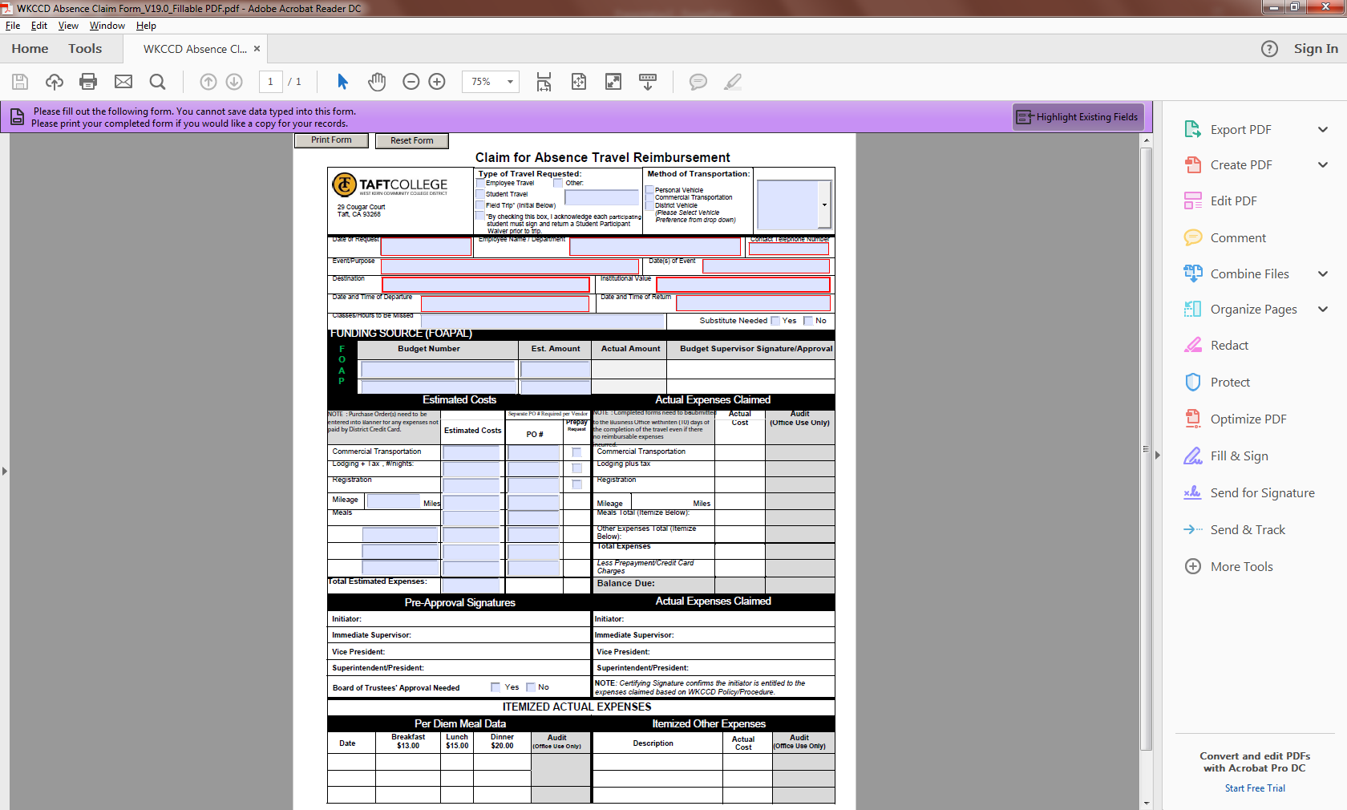
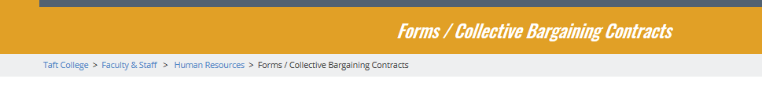
Claim for Absence / Travel
Reimbursement Form
Condensed previous forms into one simplified form.
Form now replaces:
  Absence Request Form
  Travel Reimbursement Claim Form
  Transportation Request Form
Access for on HR’s website:

Slide 8
Required Approval
Steps required to achieve an active travel status.

Slide 9
Step #1 - Approvals
Initiator will complete the travel request form and present it to both their immediate supervisor & department’s Vice President for initial approval.
If requesting advanced payment for conference fees, lodging and transportation, it will need to be indicated on the travel form and final approval submitted to the Business Office at least 30 days in advance of the travel to allow for processing.
It will be necessary to attach all pertinent backup documents with the travel form for initial approval.

Slide 10
Step #1 - Approvals
Purchase orders must be submitted in Banner for the estimated costs being requested. PO #’s need to be indicated on the form.
  NOTE: A separate Purchase Order needs to be created for each vendor requesting to be paid. For example:
    PO #1 – Hotel (Prepayment Requested)
    PO #2 – Registration (Prepayment Requested)
    PO #3 – Employee Traveling (Meal & Mileage Reimbursement)
The “Claim for Absence / Travel Reimbursement” form is required even if expenses are not expected to be incurred.

Slide 13
Step #2 - Approvals
Approved travel forms with appropriate documentation are to be forwarded to the Superintendent/President’s office for final approval prior to the date of the trip.
If traveling outside the United States, Board approval is required.
Approved travel packets will be forwarded to the Business Office.

Slide 14
Step #3 - Approvals
The Business Office will process any advanced payment requests if received within 30 days of travel & purchase orders have been submitted.
If requesting a District Vehicle, a copy of the approved travel request form will be forwarded to M&O for processing.
The Business Office will return the original “Claim of Absence / Travel Reimbursement” form back to the employee traveling. The form must be returned to the Business Office after travel has been completed.
  NOTE: Until the employee received the original form back, their travel has not been fully process & approved.

Slide 15
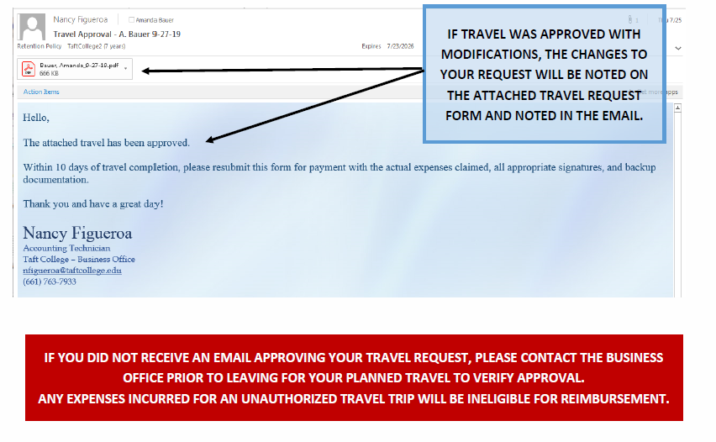

Slide 16
Submitting for Reimbursement

Slide 17
After Completed Travel
After travel has been completed, the employee must record actual expenses incurred within the appropriate section of the original “Claim of Absence / Travel Reimbursement” form.
All necessary receipts and backup must be attached to the form when re-submitted for processing.
Employee, supervisor, area administrator must approval all final expenses.
  The Superintendent/President will only need to approve final expenses unless an exception to policy is being made.
Forms must be returned to the Business Office within ten (10) days after travel has been completed.

Slide 19
Summary of Reimbursements

Slide 20
Meal Per Diem
Breakfast: $13.00
  Trip begins at or before 7:00 am and ends at or after 10:00 am
Lunch: $15.00
  Trip begins at or before 11:00 am and ends at or after 2:00 pm
Dinner: $20.00
  Trip begins at or before 4:00 pm and ends at or after 7:00 pm
Per Diem may not be claimed for any meals provided at the conference, regardless of whether the employee chooses to consume the meal(s) provided.

Slide 21
Ground Transportation
District/Personal Vehicle:
  Use of a District fleet vehicle is encouraged but not mandatory.
  Transportation method must be indicated on the travel request form.
    District Vehicles – Gas Expenses are reimbursed (Receipts Required)
    Personal Vehicles – Mileage is paid at the current approved rate IRS rate. (Round trip Mileage Route Map required).
Rental Car:
  Use of rental vehicle must be itemized on the travel request form. (Receipts Required).
Public Transportation:
  Taxi, bus, ferry, shuttle, metro fares and other forms of public ground transportation are reimbursable when it is necessary. (Receipts Required).

Slide 22
Air Transportation
Lowest available airfare in coach or economy class tickets that reasonably meets District travel needs for domestic and international flights.
Encouraged to book flights at least 14 days in advance to avoid premium pricing.
Non-Reimbursable:
  Upgraded seating resulting in a higher-priced coach ticket.
  Additional costs associated with changing orginially booked ticket for convenience of the employee.

Slide 23
Lodging
Allowable when travel is forty (40) miles or more from the traveler’s home or primary worksite.
Reasonable, single occupancy, standard business room rates, or limited to conference room rate when the conference provides hotel rates.
Lodging costs only for the appropriate and reasonable amount of time to conduct official business will be reimbursed.

Slide 24
Summary of Non -Reimbursements

Slide 25
Some Examples include:
Reimbursable expenses without proper receipts and documentation.
Alcoholic beverages
Entertainment expenses, movie rentals, and other luxury items similar in nature.
Upgrades to hotel rooms and airfare.
Traffic or parking citations.

Slide 26
Denial Appeal Process

Slide 27
What happens if a reimbursement is denied?
If the documentation provided for reimbursement does not follow AP 7400 policies, then it may be adjusted at time of final reimbursement.
Some common denial reasons include:
  Mileage calculated incorrectly
  Meal Per Diem claimed for meals provided at conference.
  Final start time/end time not consistent with paperwork provided to warrant a meal per diem.
  Missing itemized receipt.
  Late submission of final reimbursement paperwork.

Slide 28
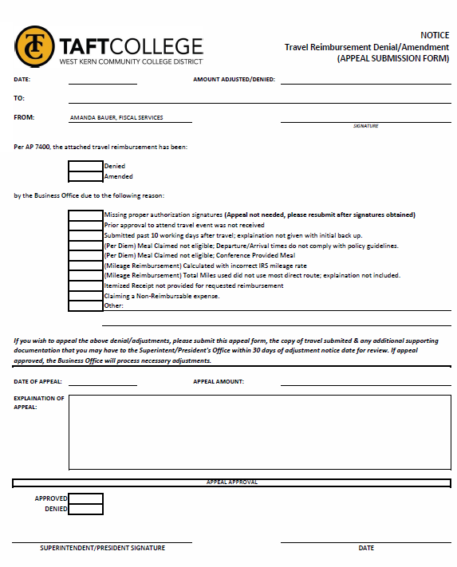
Fill out the appeal form and submit to the Superintendent/President’s office for approval.
Ensure to attach any missing documentation (i.e. receipts, explanation memos, etc.) to validate the reason for the appeal.
If approved, the Business Office will process the reimbursement within normal AP processing window times.

Slide 29
Other Travel Types

Slide 30
Student Travel:
Student who is traveling on behalf of the District shall follow the same parameters set for a District employee.
The Student is also required to sign and submit a “Student or Participant Waivers” form to the appropriate VP prior to the travel date.

Slide 31
Field Trip Travel:
Field trips shall follow the same parameters set for a District employee travel requirements expect in regards to the following:
  Transportation reimbursements are only eligible with an approved District vehicle request. If student elects to use their personal vehicle as a mode of transportation, mileage may not be claimed.
  Field Trips are ineligible for a claim for meal per diem rates.
  All students participating must sign and submit a “Student or Participant Waivers” form to the appropriate VP prior to the travel date.
  Only students, faculty and TC employees associated with the course names on the field trip by attend.

Slide 32

THANK
YOU!
Amanda Bauer
Phone
661-763-7853
Email
abauer@taftcollege.edu

