Slide 1

Taft College
Educational Master Plan Committee
October 18, 2024

Slide 2
Session Agenda
College Update
Project Update
Internal Data and Trends; Student Outcomes; Student Success Metrics
Listening Session Themes
Taft College Challenges and Opportunities
Next Steps and Closing Remarks

Slide 3
Data and Trends
internal data, student outcomes by educational journey

Slide 4
Internal Scan: Taft College Students
Headcount, Enrollment and FTES
Demographics
Outcomes: Awards, Transfer, Employment

Slide 5
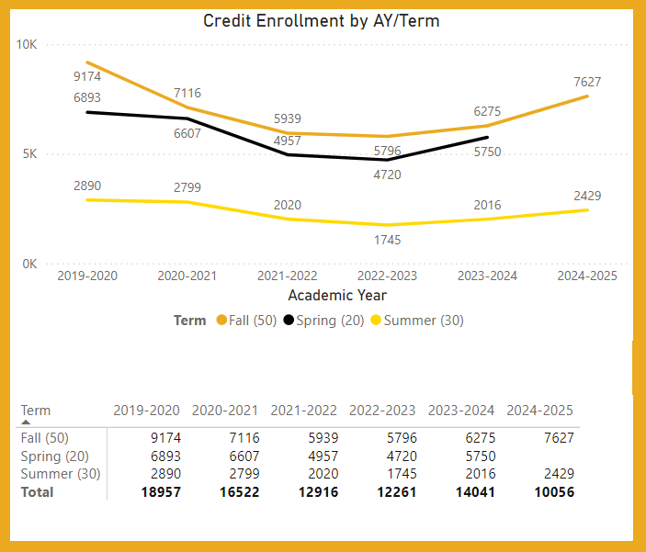
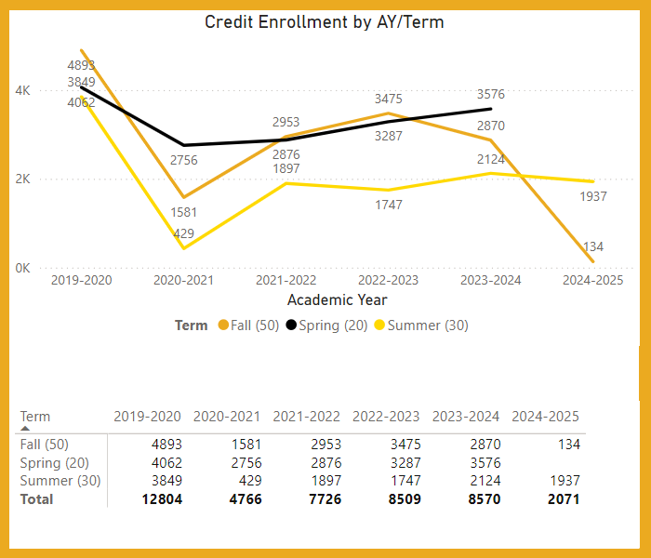
Enrollment Trends, Fall 2024
Taft campus
Westec
Enrollment at both the Taft campus and Westec has been rebounding since the Covid-19 Pandemic
(Note: Westec enrollment numbers are not finalized until end of term due to short-term courses throughout the semester)
Source: Taft College Daily Enrollment dashboard, extracted 9/25/2024

Slide 6
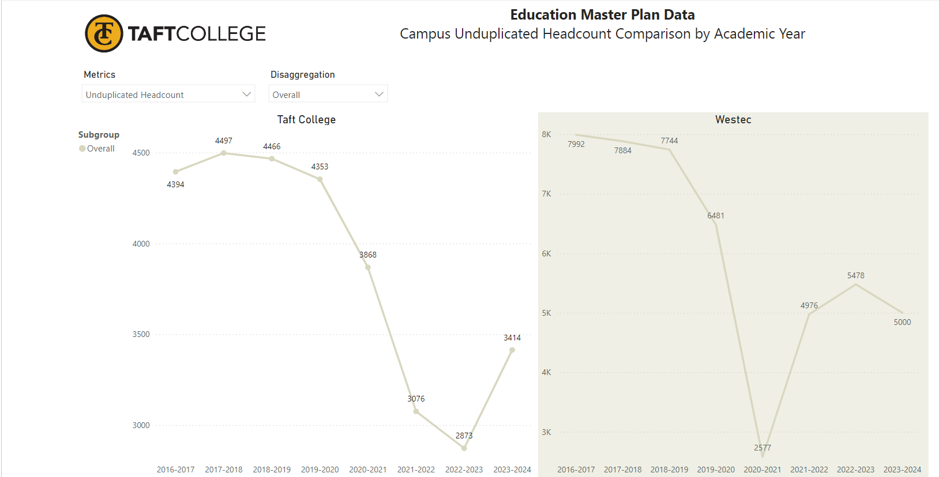
Headcount
At both campuses, enrollment was fairly stable until it dropped during the Covid-19 Pandemic
Prior to the Pandemic, nearly 4,500 students were enrolled annually at the Taft campus, and nearly 8,000 at Westec
In most years, Westec has accounted for approximately 60% of Taft College students
(Note: the scale is different in each chart)
Source: Taft College Office of Institutional Research and Planning

Slide 7
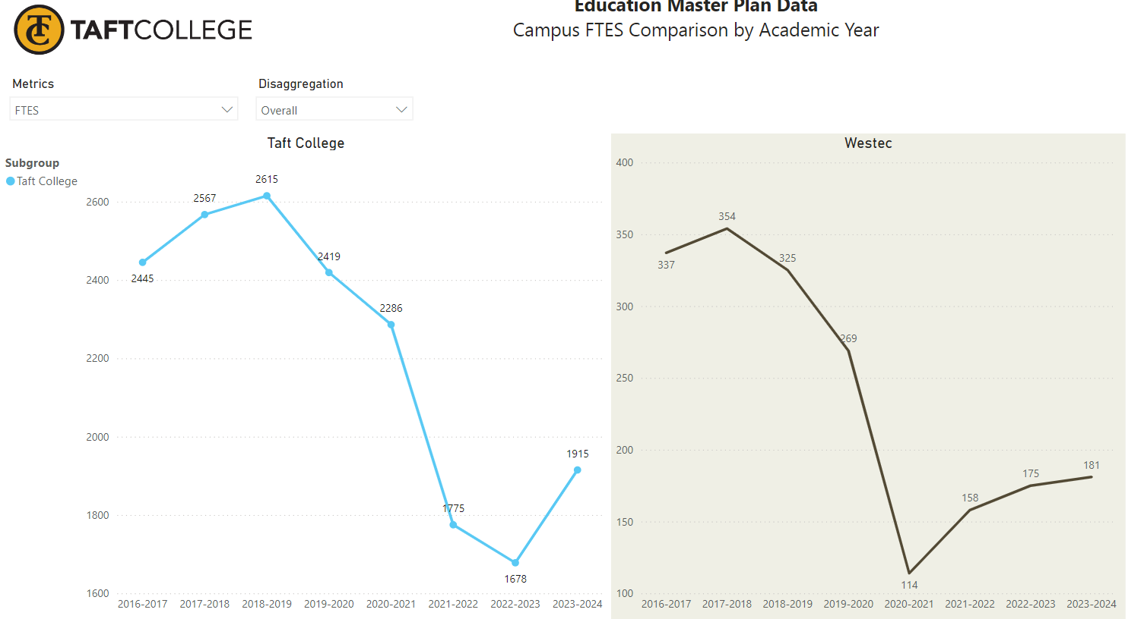
FTES
At both campuses, FTES was fairly stable until it dropped (along with headcount) during the Covid-19 Pandemic
Prior to the Pandemic, FTES at the Taft campus hovered around 2,500 while it was closer to 325 at Westec
In most years, Westec has accounted for approximately 10% of Taft FTES
(Note: the scale is different in each chart)
Source: Taft College Office of Institutional Research and Planning

Slide 8
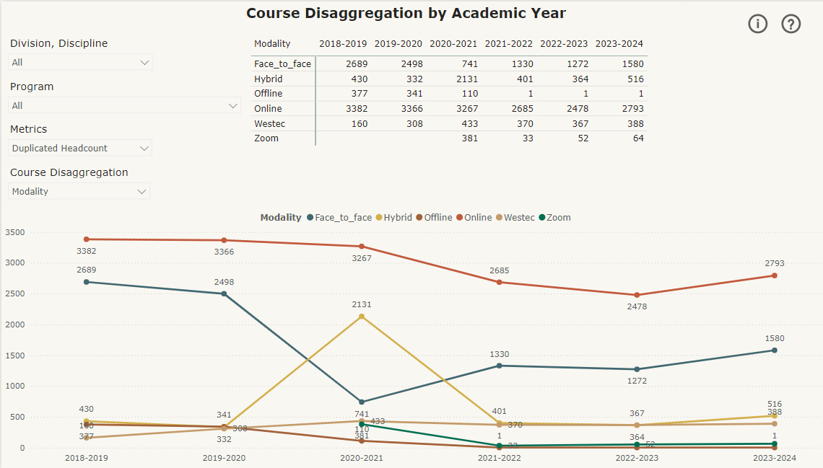
Enrollments by Modality
Even prior to the Covid-19 Pandemic, Taft College had higher online enrollments than face-to-face
During the peak of the pandemic, enrollments in hybrid courses increased, and face-to-face decreased, with more enrollments online
Post-pandemic, hybrid enrollments subsided to pre-pandemic levels, and face-to-face enrollments rebounded (but not yet to pre-pandemic levels)
(Note: Offline courses are correspondence, and Zoom are specific time online courses, and not all Westec enrollments are included)
Source: Taft College Office of Institutional Research and Planning

Slide 9
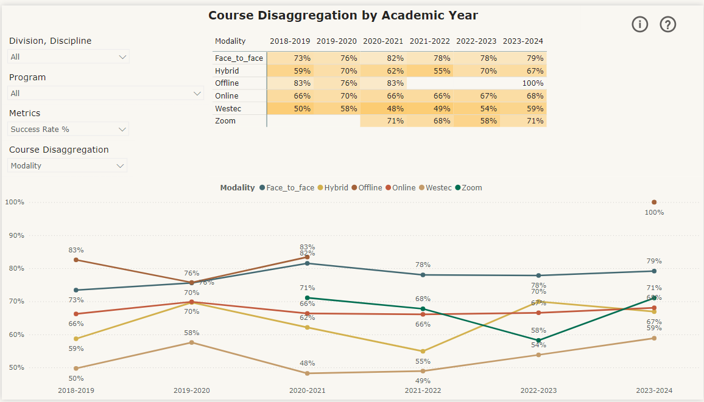
Success Rate by Modality
Success rates have been highest in face-to-face classes, at 79% in 2023-2024
Over time, success rates have been lower in online and hybrid courses (68% and 67%, respectively, in 2023-2024)
(Note: Not all Westec enrollments are included)
Source: Taft College Office of Institutional Research and Planning

Slide 10
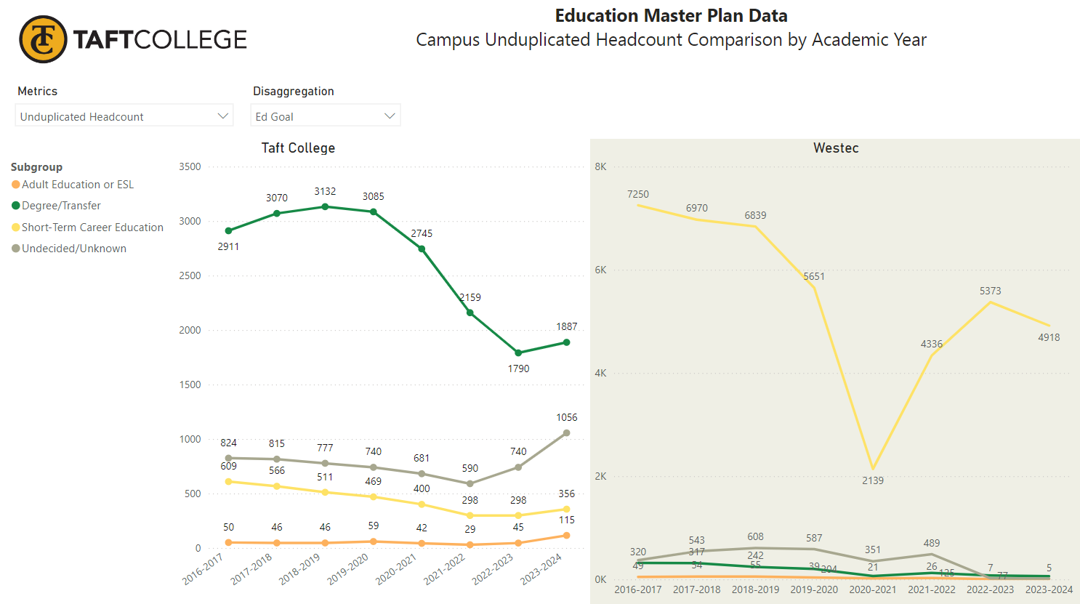
Educational Goal
The majority of students at the Taft campus have Degree/Transfer as their educational goal
At Westec, the majority have Short Term Career Education as their career goal
(Note: the scale is different in each chart)
Source: Taft College Office of Institutional Research and Planning

Slide 11
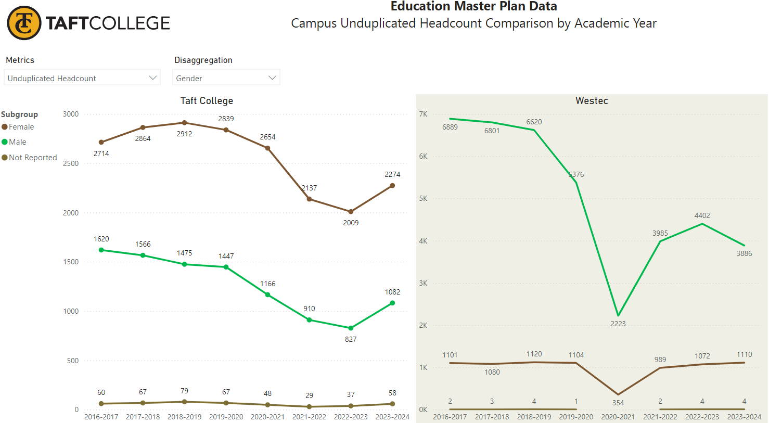
Gender
At the Taft campus, the majority of students are female, about 2:1
At Westec, the majority of students are male, about 4:1
(Note: the scale is different in each chart)
Source: Taft College Office of Institutional Research and Planning

Slide 12
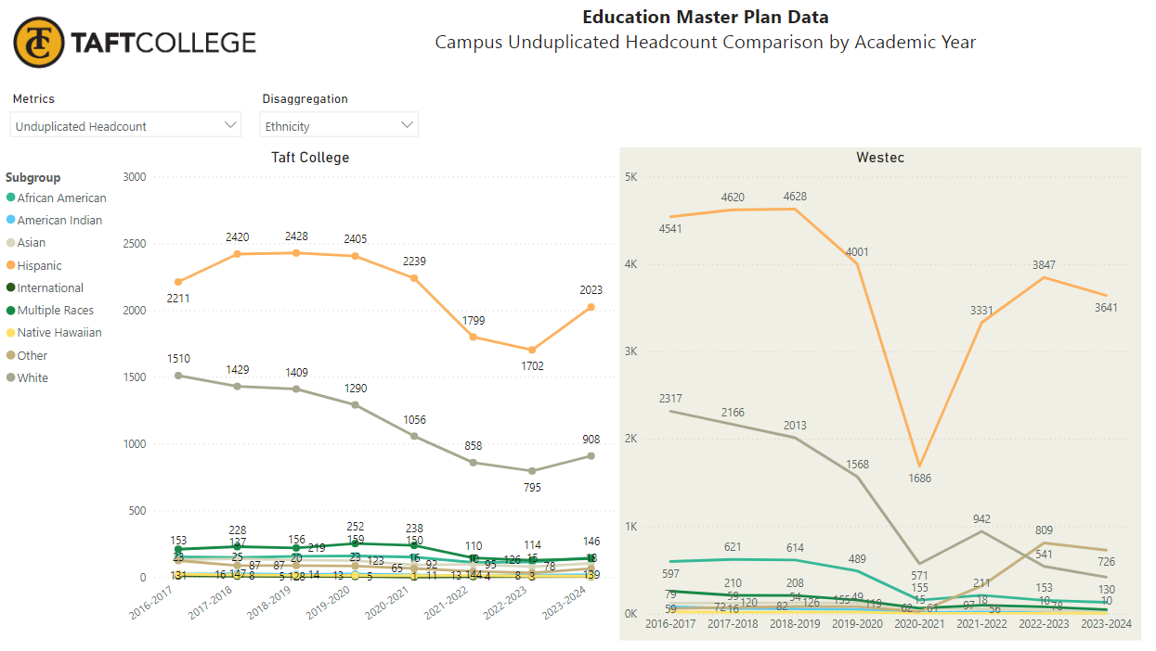
Ethnicity
At both the Taft campus and Westec, the majority of students are Latino, followed by Whites
(Note: the scale is different in each chart)
Source: Taft College Office of Institutional Research and Planning

Slide 13
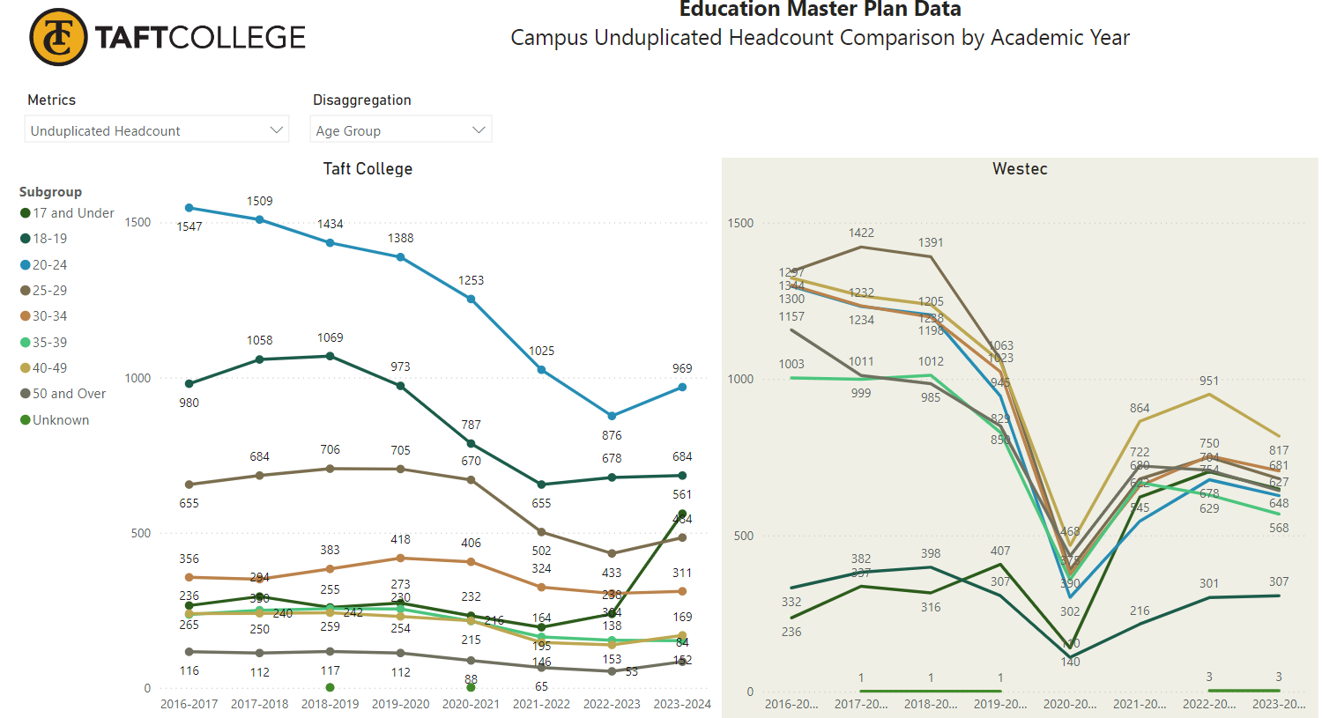
Age
At the Taft campus, the student population is younger, more traditionally college aged (24 and under)
At Westec, the student population is older, with the majority being 25 and older
(Note: the scale is different in each chart)
Source: Taft College Office of Institutional Research and Planning

Slide 14
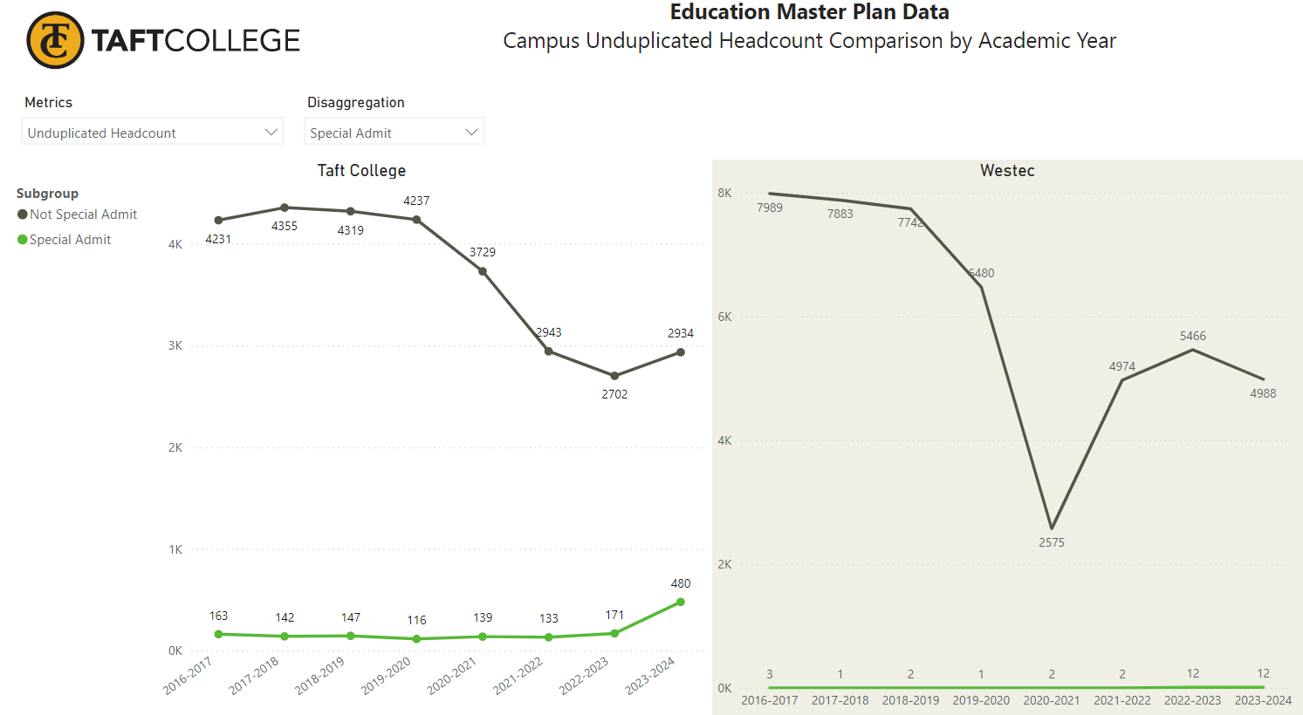
Special Admit
The vast majority of of Taft College students who are “Special Admit” are enrolled at the Taft campus
The number of Special Admit students has tripled since before the Pandemic
In 2023-2024, Special Admit students accounted for 14% of headcount at the Taft campus (and 5% of FTES, which is not shown on this chart)
(Note: the scale is different in each chart)
Source: Taft College Office of Institutional Research and Planning

Slide 15
Student Type (excludes Westec)
There is twice the proportion of First-Time Transfer Students at Taft College than statewide at all CCCs
Proportionally, there are fewer continuing students at Taft than statewide
(Comparable data for Westec is currently not available)
Fall 2023 Enrollment Status | Taft campus | CCCs
First-Time Student | 18.2% | 17.5%
First-Time Transfer Student | 16.8% | 7.9%
Returning Student | 13.0% | 12.1%
Continuing Student | 41.0% | 51.2%
Special Admit Student | 10.9% | 11.2%
Total Number | 2,376 | 1,449,392
Source: Internal data from Taft College Office of Institutional Research and Planning, statewide data from CCCCO DataMart

Slide 16
Declared Majors (excludes Westec)
Top Declared Majors | 2019/20 | 2020/21 | 2021/22 | 2022/23 | 2023/24
Liberal Arts Allied Health | 543 | 583 | 491 | 486 | 539
Business Administration 2.0 | 0 | 0 | 3 | 131 | 246
Psychology for Transfer | 280 | 281 | 239 | 210 | 222
Engineering | 188 | 164 | 156 | 142 | 188
Early Care Educ for Transfer | 255 | 231 | 183 | 179 | 186
Biology for Transfer | 224 | 176 | 142 | 124 | 159
Elementary Teacher Ed | 0 | 3 | 70 | 116 | 150
Life Science | 235 | 178 | 120 | 100 | 126
Kinesiology for Transfer | 102 | 97 | 66 | 75 | 109
Business Administration | 116 | 95 | 63 | 71 | 105
Admin of Justice for Transfer | 177 | 131 | 98 | 76 | 89
General Business | 236 | 139 | 56 | 74 | 88
Early Care Ed & Family Studies | 158 | 146 | 100 | 66 | 79
Liberal Arts Communication | 139 | 111 | 95 | 72 | 68
Sociology for Transfer | 128 | 128 | 101 | 66 | 67
Over the past five years, Liberal Arts for Allied Health has remained the most popular major for Taft College students.
Business Administration 2.0 and Elementary Teacher Ed gained popularity quickly after being introduced
Source: Taft College Office of Institutional Research and Planning, Majors-Count-2021-AY-1920-to-2324.xls

Slide 17
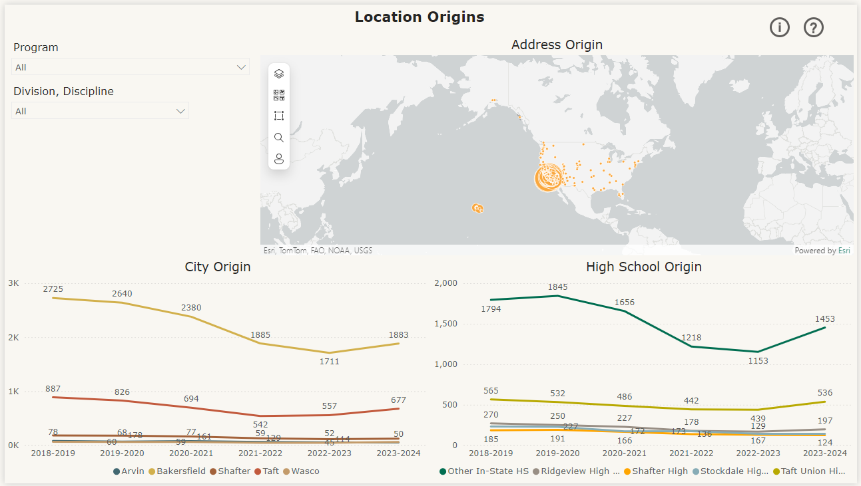
Location and HS Origins, 2023-2024 (excludes Westec)
The preponderance of Taft students are from Bakersfield
The second largest student group by town is from Taft, followed by Shafter, Wasco and Arvin
The high school sending the greatest number of students to Taft College is Taft High School, followed by Ridgeview, Stockdale and Shafter high schools
Source: Taft College Office of Institutional Research and Planning

Slide 18
Enrollment by Zip Code, 2023-2024
Over half of Taft College students (excluding Westec) have residential ZIP codes in Bakersfield – this proportion has decreased; in recent years it was 60-61%
One-fifth of Taft College students live in Taft – this proportion has been stable over the past few years
Nearly another fifth of students are from regional towns, including Shafter (3.5%), Lompoc (2.7%), Wasco (1.8%), Arvin (1.5%), Santa Maria (1.4%) and Lamont (1.2%)
Location (based on ZIP code of residence) | % of Headcount in AY 2023-2024
Bakersfield | 55.0%
Taft | 19.8%
17 other regional towns | 17.1%
Other California | 6.0%
Out of State | 1.6%
Unknown | 0.4%
Source: Taft College Office of Institutional Research and Planning, Location&Modality_Final+1.xls

Slide 19
Local Community College Choices
In Fall 2023, there were 772 students enrolled in California Community Colleges with residential ZIP codes in Taft, Maricopa and McKittrick. Which community college did they chose to attend?
598 Taft College
101 Bakersfield College
16 Cerro Coso College
8 Porterville College
6 Santiago Canyon College
The majority of local students who attend community college are choosing Taft College
(Note: this includes Westec students)
Source: CCCCO Fall 2023 ZIP Code by College

Slide 20

Thoughts?

Slide 21
Student Outcomes
Awards, transfer, career, cccco student success metrics

Slide 22
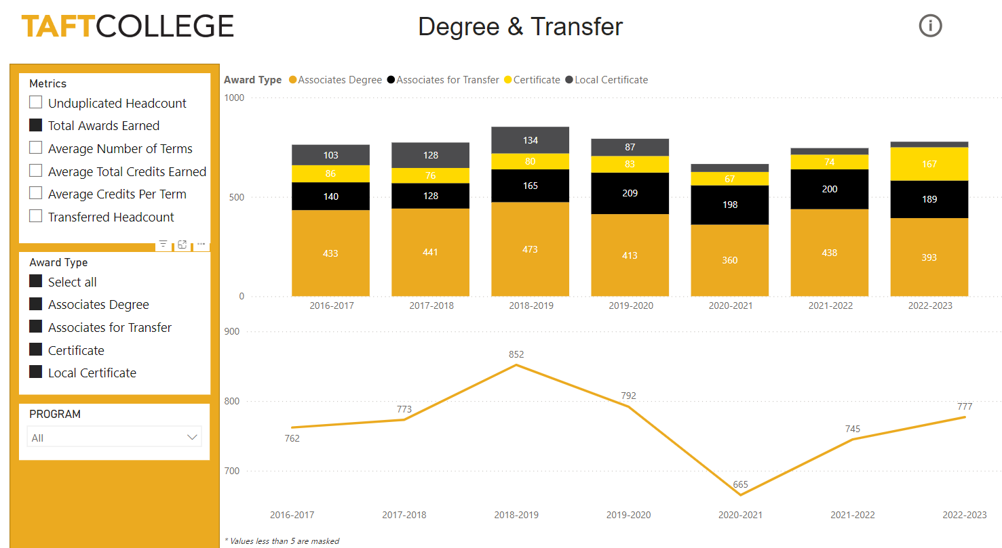
Total Awards
In 2022-2023, 777 were awarded (to date)
Taft College has awarded between 665 and 852 degrees and certificates annually over the past 7 years, with the lowest annual number during the Covid-19 Pandemic
The majority of awards are Associate degrees, and Associate degrees for Transfer
The number of certificates (non-local) awarded increased notably in 2022-23
Source: Taft College Office of Institutional Research and Planning

Slide 23
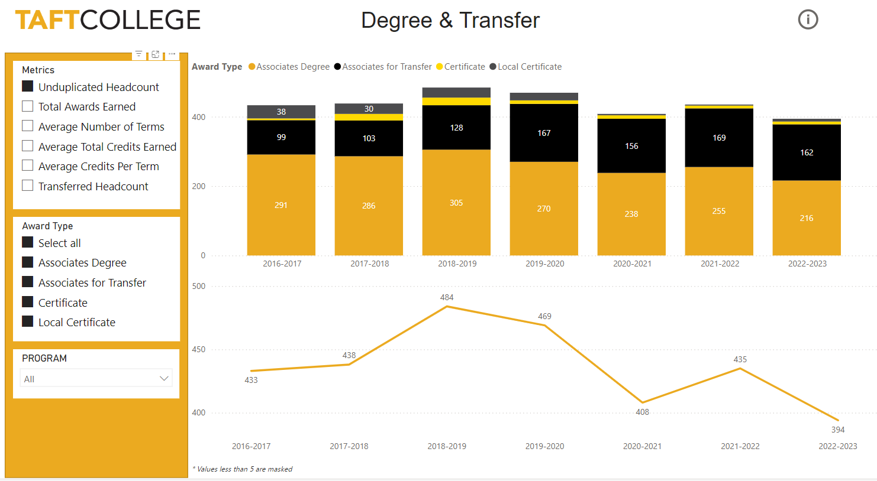
Unduplicated Student Awards
Between 394 and 484 Taft College students have earned one or more awards annually in recent years, with many earning more than one award
While more degree earning students are receiving local Associate degrees, over the past years an increasing number are earning Associate degrees for Transfer
(In 2022-2023, 777 awards were bestowed on 394 students)
Source: Taft College Office of Institutional Research and Planning

Slide 24
Top Awards, 2023-2024
Award | #
Certificate in CSU GE | 151
AA Liberal Arts Math & Science | 70
AA Liberal Arts Allied Health | 64
AS Life Science | 44
AA Liberal Arts Communication | 41
ADT-Psychology for Transfer | 30
Business Administration 2.0 | 19
AA Liberal Arts Business Techn | 18
AS Criminal Justice Admin | 18
ADT-Sociology for Transfer | 17
AA Libral Arts Natural Life Sci | 17
AS Dental Hygiene | 15
AS General Business | 15
CC in Chld Develpmnt Asst Tchr | 15
CA in Associate Teacher ECEF | 14
The most frequently bestowed Taft College award in the 2023-2024 Academic Year was “Certificate in CSU General Education”
The most popular Associate of Arts degree majors are in the Liberal Arts (Math & Science, Allied Health, Communication Business)
The most popular Associate of Science degree majors are Life Sciences, Criminal Justice and Dental Hygiene
Notably, there are two popular Associate Degree for Transfer majors, Psychology and Sociology
Source: Taft College Office of Institutional Research and Planning, Awards-Count-2021-AY-1920-to-2324+1xls

Slide 25
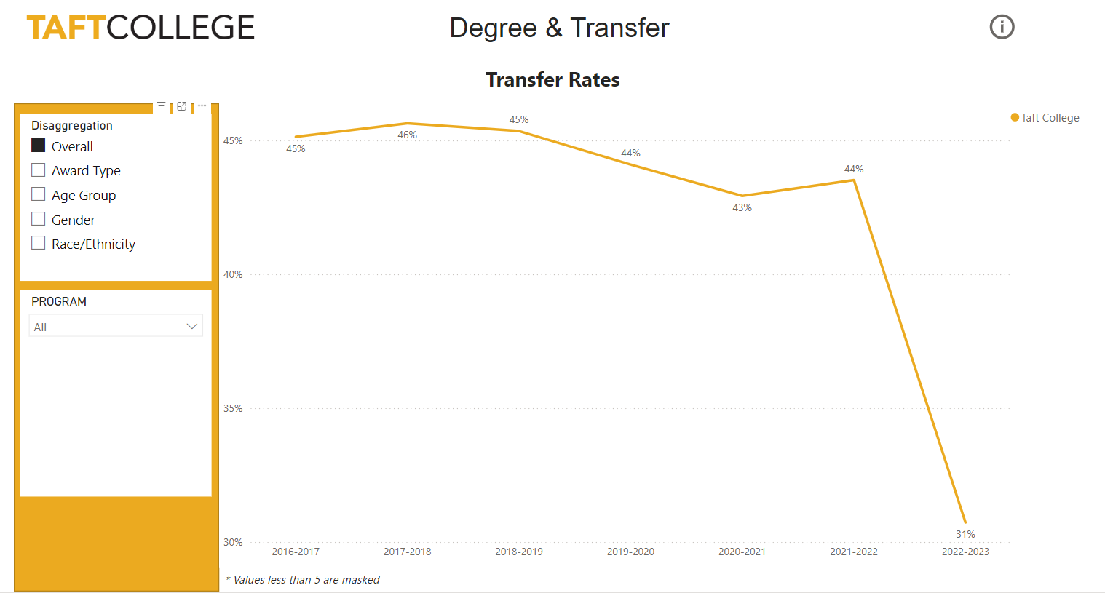
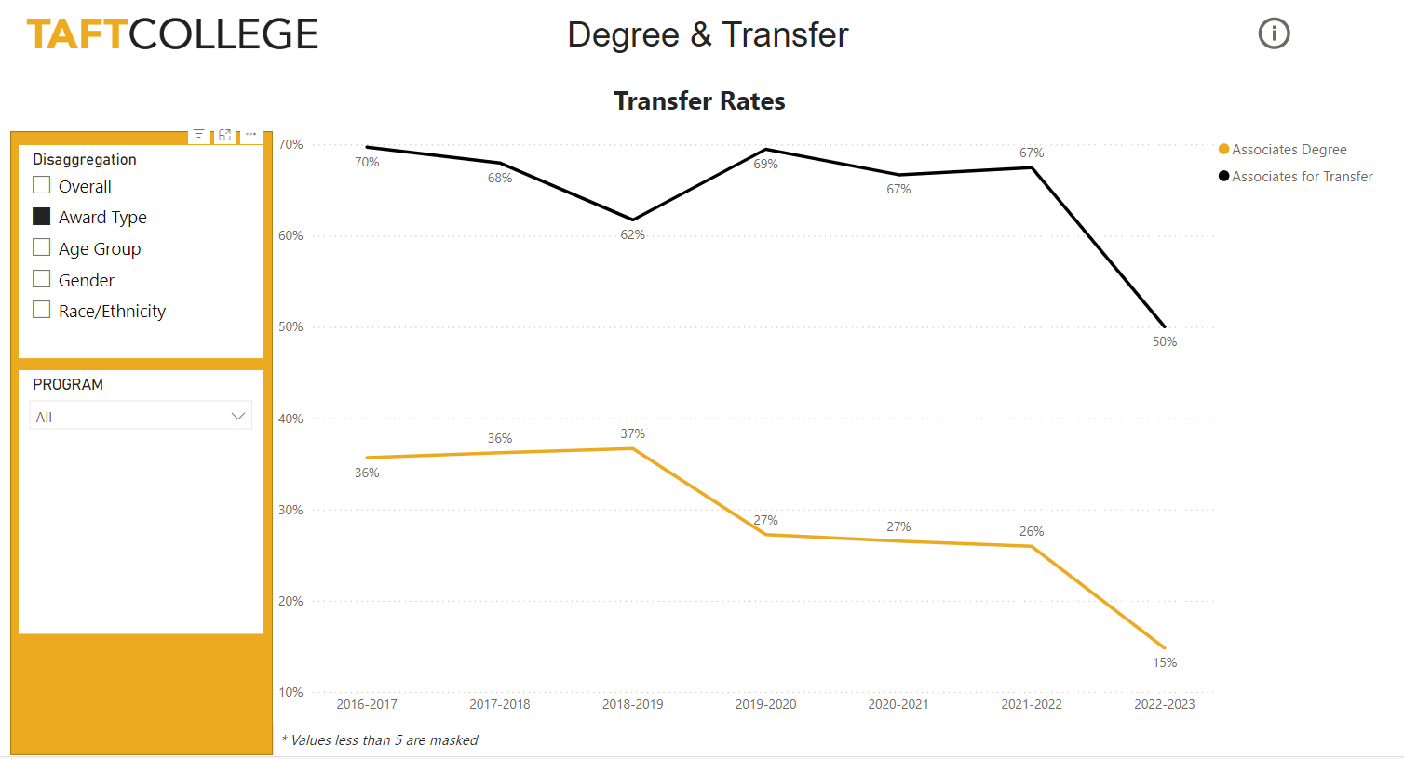
Transfer Rate
Taft College locally defines transfer rate as the percentage of degree earners who transfer to a 4-year college or university the following Fall
(Note: there is a time lag in confirming transfer data; the numbers for 2022-2023 will likely increase)
While more Taft students earn local Associate degrees than ADTs, the transfer rate for ADT earners is significantly higher
Source: Taft College Office of Institutional Research and Planning

Slide 26




Top University Transfer Destinations
Institution Name | 5-Year Total Students Transferred (18/19-22/23)
CALIFORNIA STATE UNIVERSITY - BAKERSFIELD | 505
CALIFORNIA STATE UNIVERSITY - FRESNO | 20
ARIZONA STATE UNIVERSITY | 20
FRESNO PACIFIC UNIVERSITY | 20
WESTERN GOVERNORS UNIVERSITY | 17
UNIVERSITY OF PHOENIX | 16
CALIFORNIA STATE UNIVERSITY - LONG BEACH | 14
POINT LOMA NAZARENE UNIVERSITY | 13
NATIONAL UNIVERSITY | 13
GRAND CANYON UNIVERSITY | 13
CALIFORNIA STATE UNIVERSITY- NORTHRIDGE | 13
SAN DIEGO STATE UNIVERSITY | 10
SOUTHERN NEW HAMPSHIRE- 09WEEK | 10
Source: Taft College Office of Institutional Research and Planning, Degree & Transfer PowerBI Dashboard data download

Slide 27
Career Education Outcomes, 2023
 | Taft College | All CCCs
N | 390 | 166,305
Response Rate | 24% | 23%
% Employed for Pay | 80% | 81%
Job Closely Related to Studies/Training | 67% | 71%
Program Satisfaction | 93% | 90%
Wages Prior to Studies/Training | $16.01 | $19.23
Wages After Studies/Training | $22.00 | $30.00
Change in Wages | $5.99 | $10.77
% Change in Wages | 37% | 56%
Taft College students, and CCC students statewide, show an increase in earnings after participating in career education programs.
The increase in wages brings students, on average, above the living wage
Source: California Community Colleges Career & Technical Education Employment Outcomes Survey (CTEOS)

Slide 28

Taft CTE Awards with Highest Wage Gains, 2017-2023
Taft College participates in the annual statewide CTE Employment Outcomes Survey. Aggregated survey results from 2017-2023 show the Taft College awards with the highest wage gains, an important outcome for CTE students.
Award (Major or Certificate) with Highest Wage Gain, 20217-2023
Dental Hygiene
Energy Technology
Management
Early Care, Education & Family Studies
Criminal Justice Administration
Business Administration
Structural Code Welding
Accounting
Early Childhood Education
Liberal Arts: Allied Health
Source: California Community Colleges Career & Technical Education Employment Outcomes Survey (CTEOS)

Slide 29
Thoughts?

Slide 30
Student Success Metrics:
LaunchBoard Data
student outcomes by educational journey

Slide 31
LaunchBoard Data from the CCCCO
Why is it important to look at LaunchBoard data?
  LaunchBoard data are the public face of MIS data, which is uploaded regularly by each college (including Taft) to the Chancellor’s Office
  LaunchBoard uses the same dataset that calculates SCFF (Student Centered Funding Formula)
  LaunchBoard uses the same dataset that will be used to measure each College’s progress in meeting Vision 2030 goals
  LaunchBoard provides data on other colleges, including regional and state groupings, to allow Taft to benchmark and compare
    https://www.calpassplus.org/Launchboard/Home.aspx

Slide 32
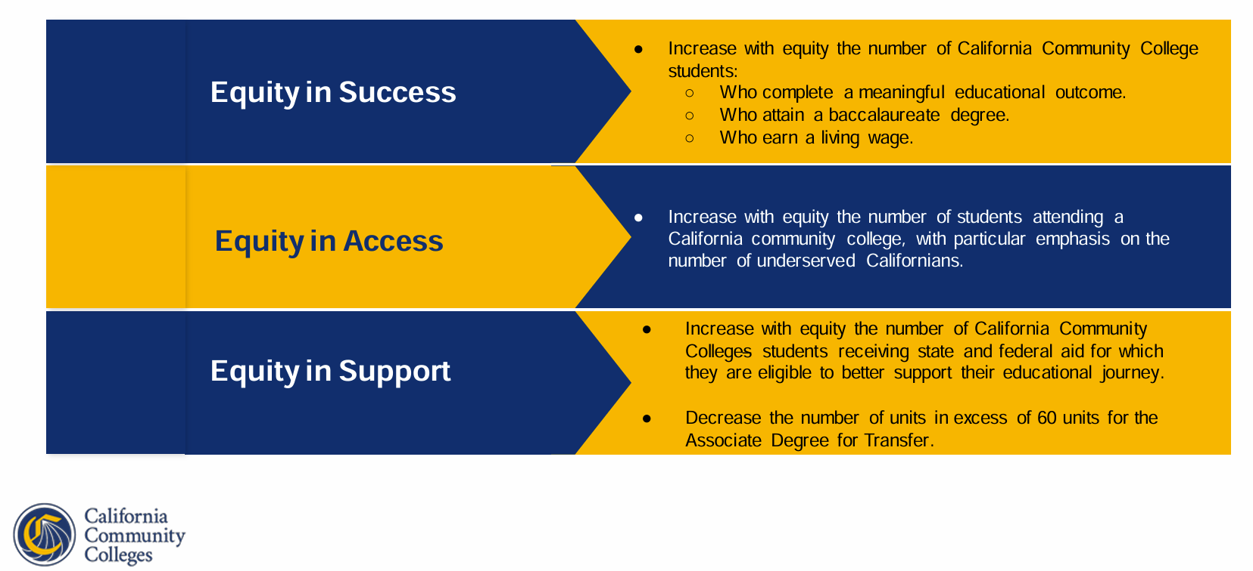
Vision 2030: Goals and Metrics

Slide 33
Student Outcomes from the CCCCO LaunchBoard
Taft Students (including Westec) by Journey, 2021-22
Taft College
South Central Valley/Motherlode CCCs
All CCCs
N=7,244
N=111,516
N=7,244
Compared to regional community colleges and all CCCs statewide, Taft has a much larger proportion of short-term CTE and much smaller proportions of Degree/Transfer, Undecided/Other, and Short-Term/ESL
Regional comparison includes Bakersfield, Cerro Coso, Clovis, Sequoias, Fresno, Porterville, Madera, Reedley, West Hills

Slide 34
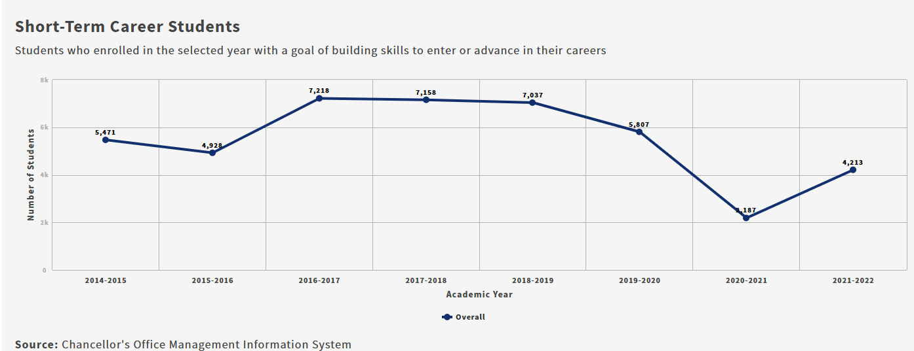
Taft College Short-Term CTE Students
(primarily at Westec)
4,213 Taft students in 2021-22, or about 58%, were categorized as Short-Term CTE
Includes: Students with career related goals such as earn a certificate, discover/prepare for/advance in career, maintain certification/licensure
Does not include Special Admits

Slide 35
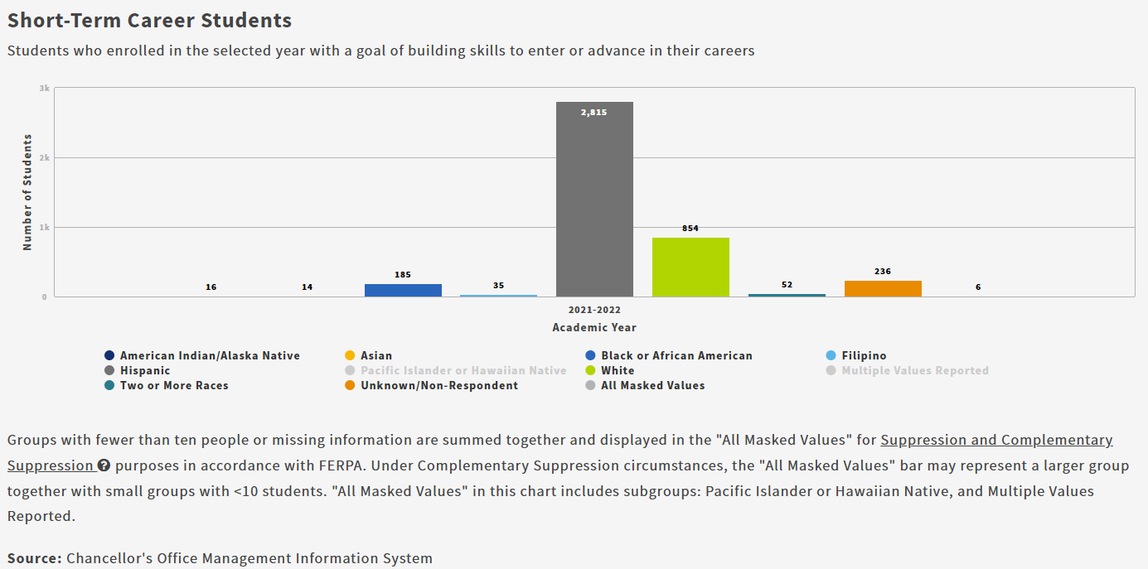
Taft College Short-Term CTE Students
(primarily at Westec)
The majority of Short-Term CTE students are Latino, and Male

Slide 36
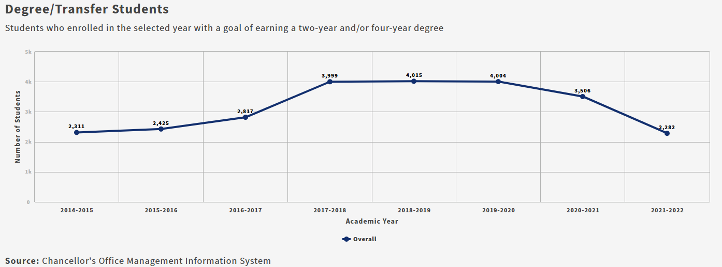
Taft College Degree/Transfer Students
(primarily at the Taft Campus/online)
2,282 Taft students in 2021-22, or about 32%, were categorized as Degree/Transfer
Includes: Students with goals of earning an Associate Degree and/or transferring to a 4-year college
Does not include Special Admits

Slide 37
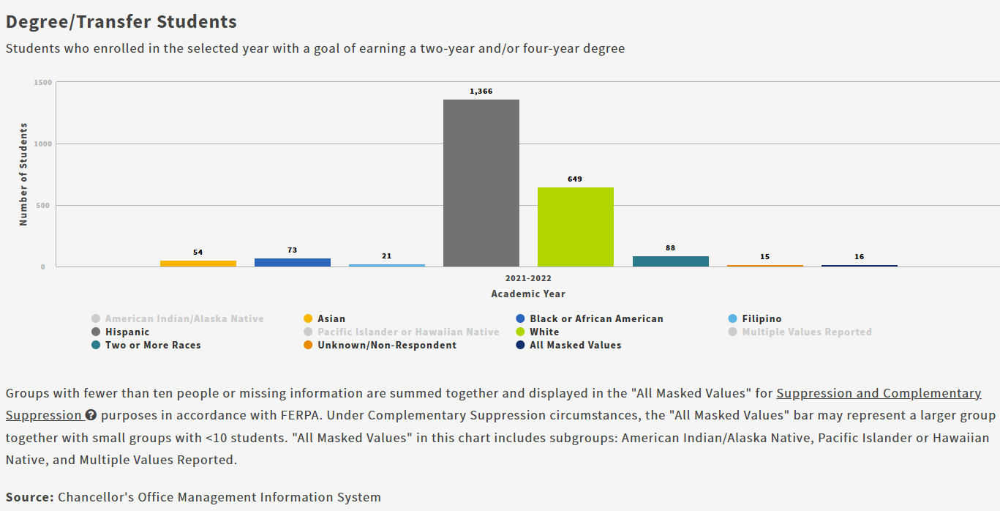
Taft College Degree/Transfer Students
(primarily at the Taft Campus/online)
The majority of Degree/Transfer students are Latino, and Female

Slide 38
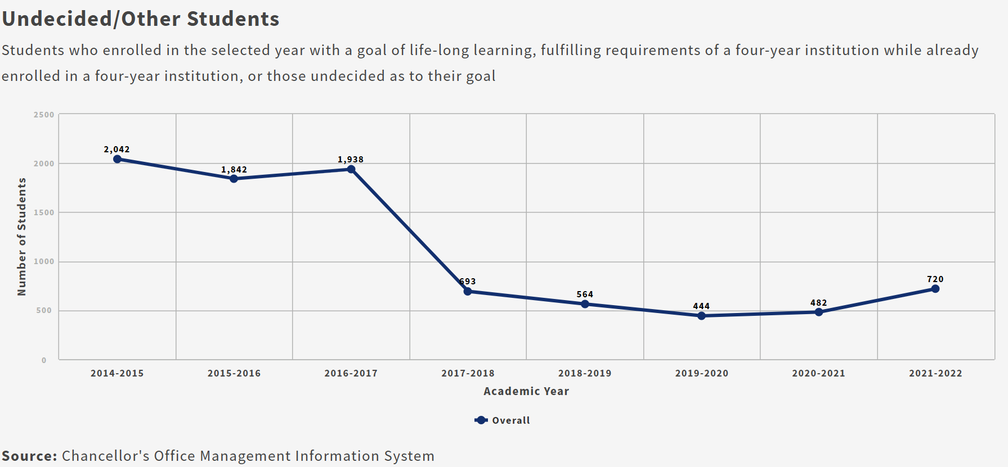
Taft College Undecided/Other Students
720 Taft students in 2021-22, or about 10%, were categorized as Undecided/Other, which is a catch-all category
Includes: Students with goals of undecided, life-long learning, 4-year college student taking credits, or no info available
Does not include Special Admits

Slide 39
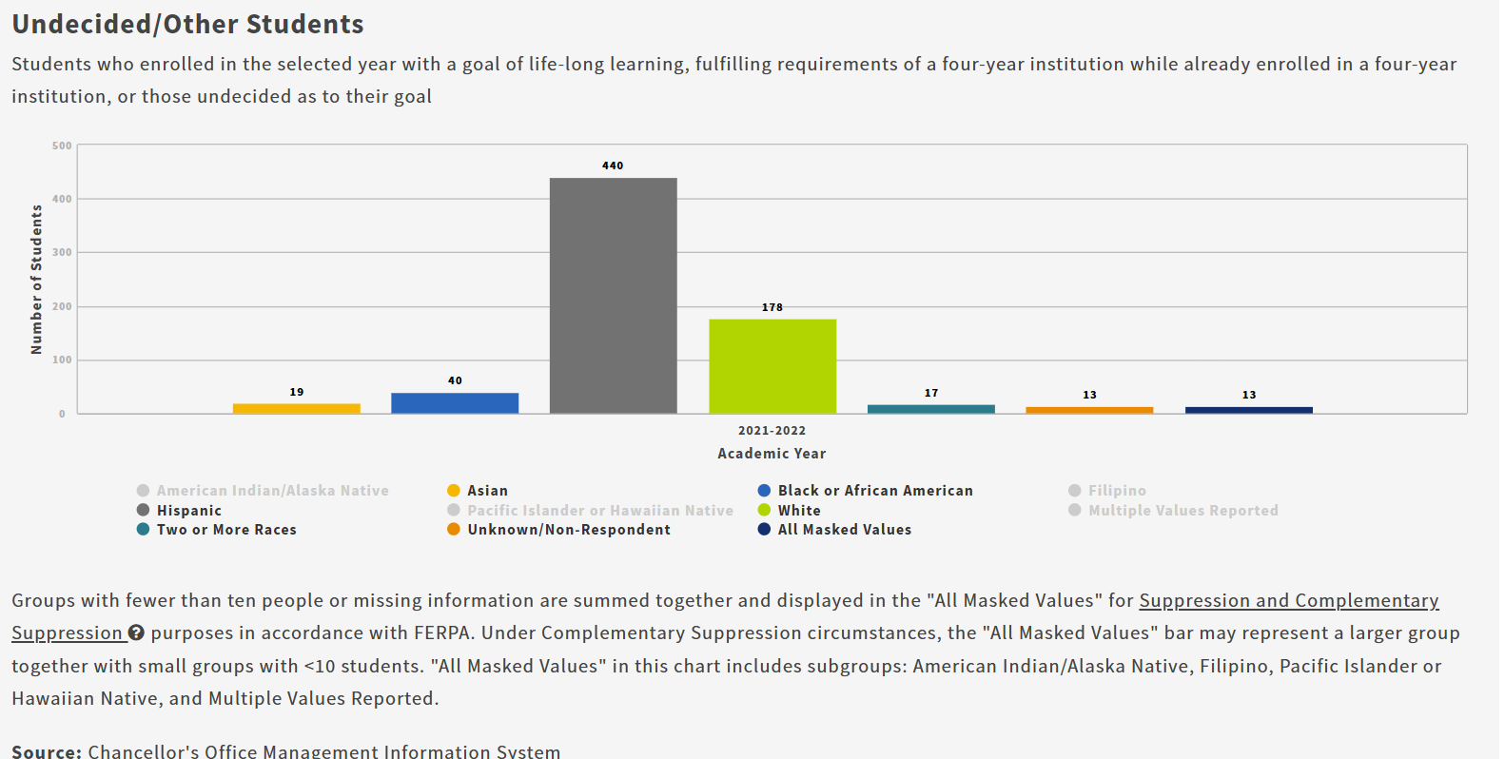
Taft College Undecided/Other Students
The majority Undecided/Other students are Latino, and Female – but the gender split is close to even

Slide 40
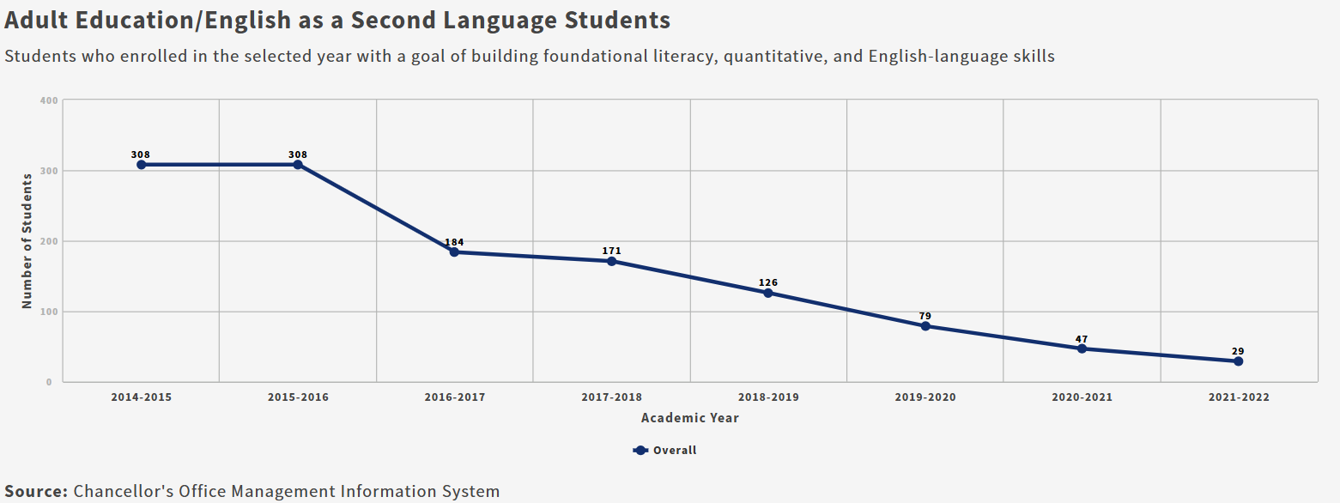
Taft College Adult Ed/ESL Students
29 Taft students in 2021-22, or less than 1%, were categorized as Adult Ed/ESL
Includes: Students with goals of improving basic skills (including English), GED prep, and/or transition from noncredit to credit coursework
Does not include Special Admits

Slide 41
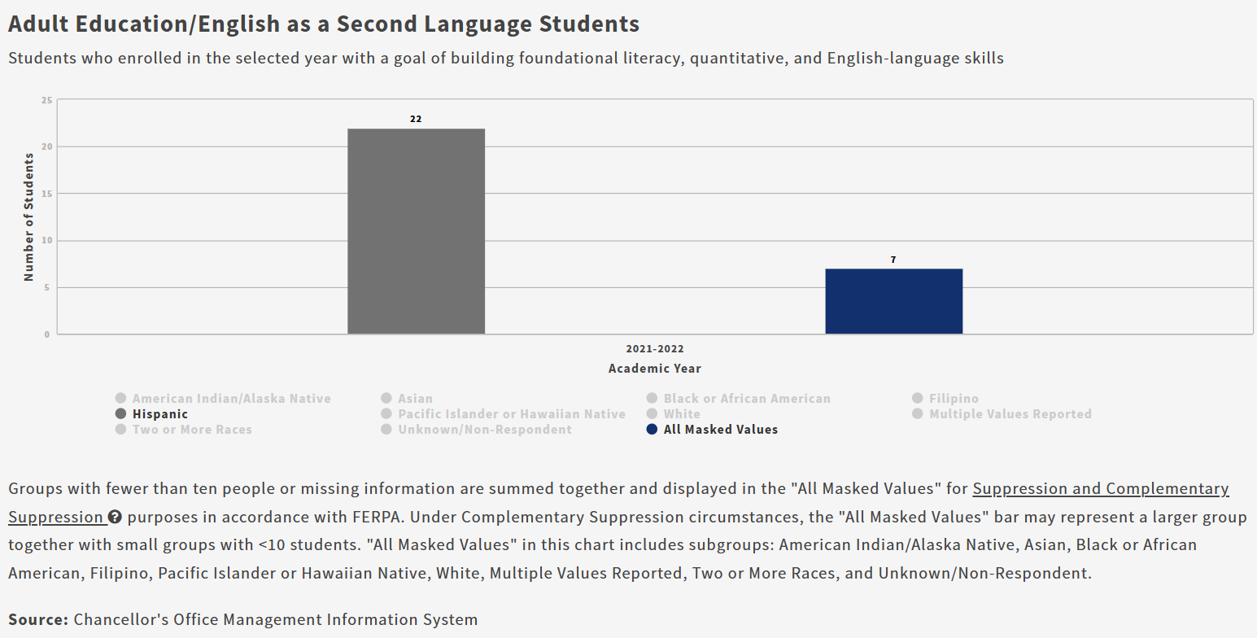
Taft College Adult Ed/ESL Students
Disaggregation by gender not available due to small population size
The majority of Adult Ed/ESL students are Latino

Slide 42
Thoughts?

Slide 43
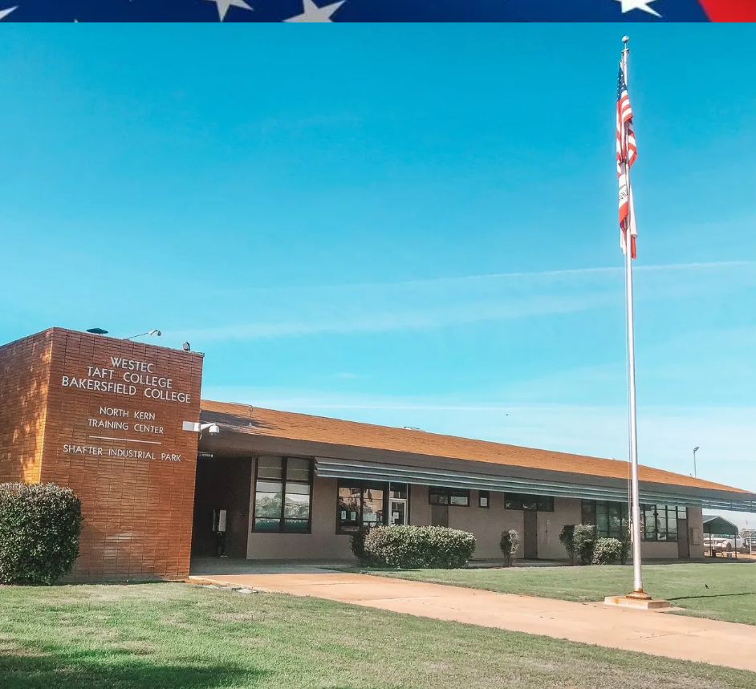

Taft Short-Term CTE Students

Slide 44
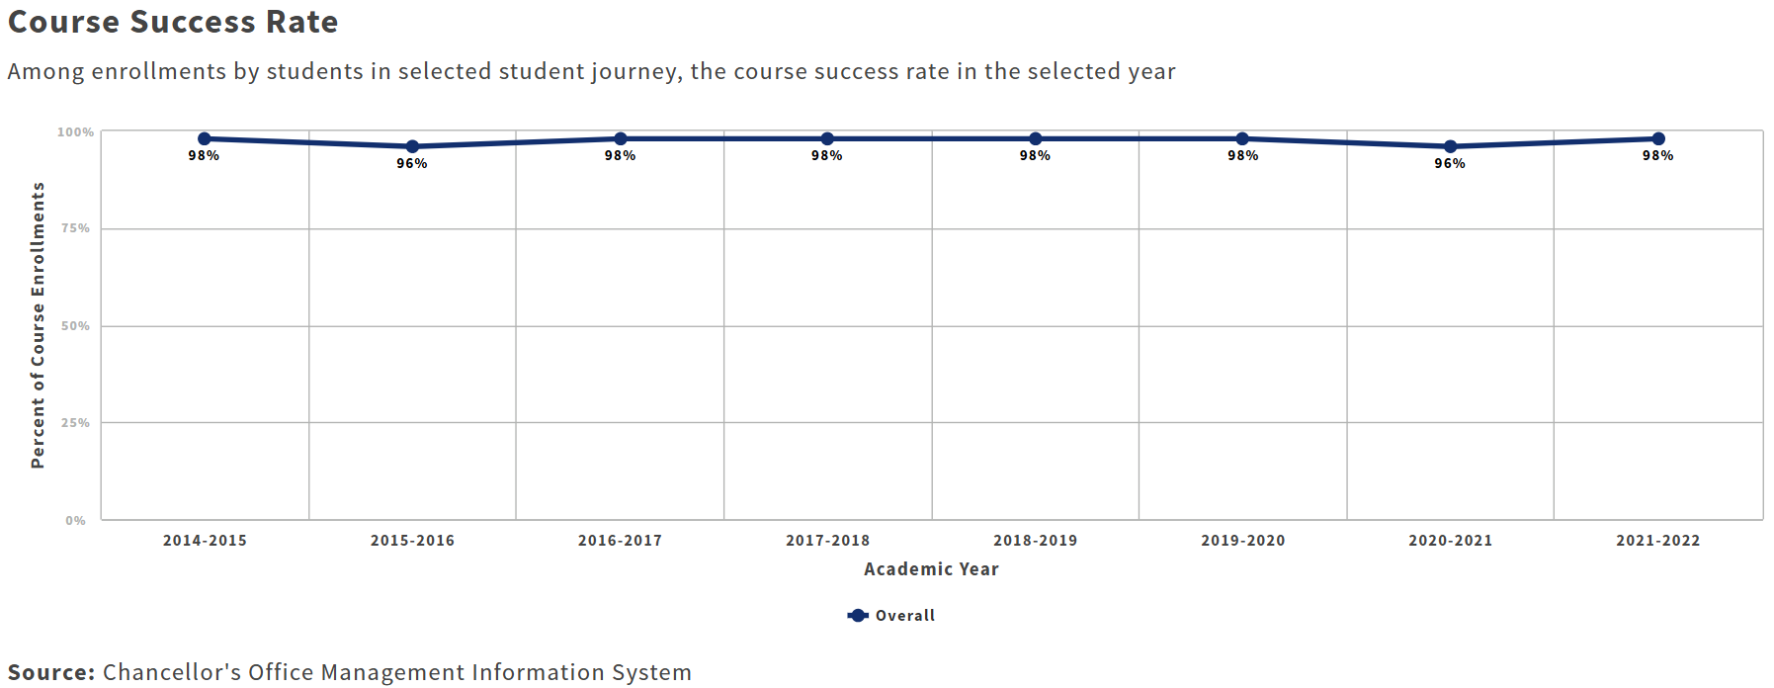
LaunchBoard: Short-Term CTE (primarily Westec campus)
Over half of Taft College students have a Short-Term CTE educational goal, and are primarily at the Westec campus
Taft College course completion rates for Short-Term CTE have remained high in recent years, between 96% and 98%, and are higher than the regional and state averages

Slide 45
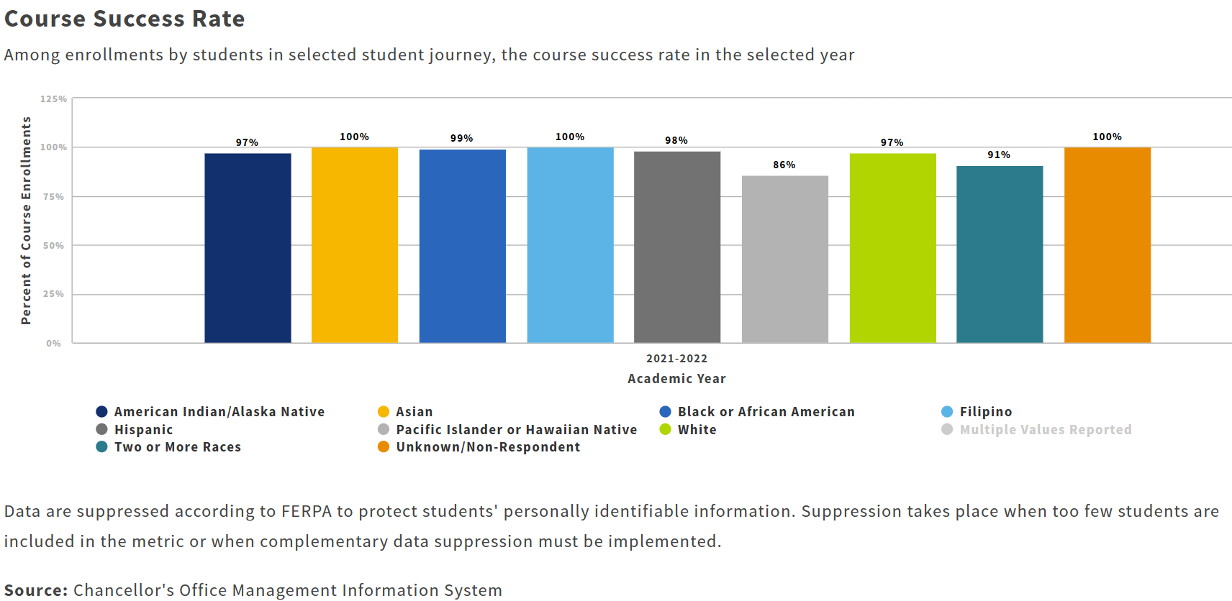
LaunchBoard: Short-Term CTE (primarily Westec campus)
Course completion rates are high for all ethnic groups, but lower for Pac Islander/HI and Multi Ethnicity
Course completion rates are slightly lower for female students than for male students

Slide 46
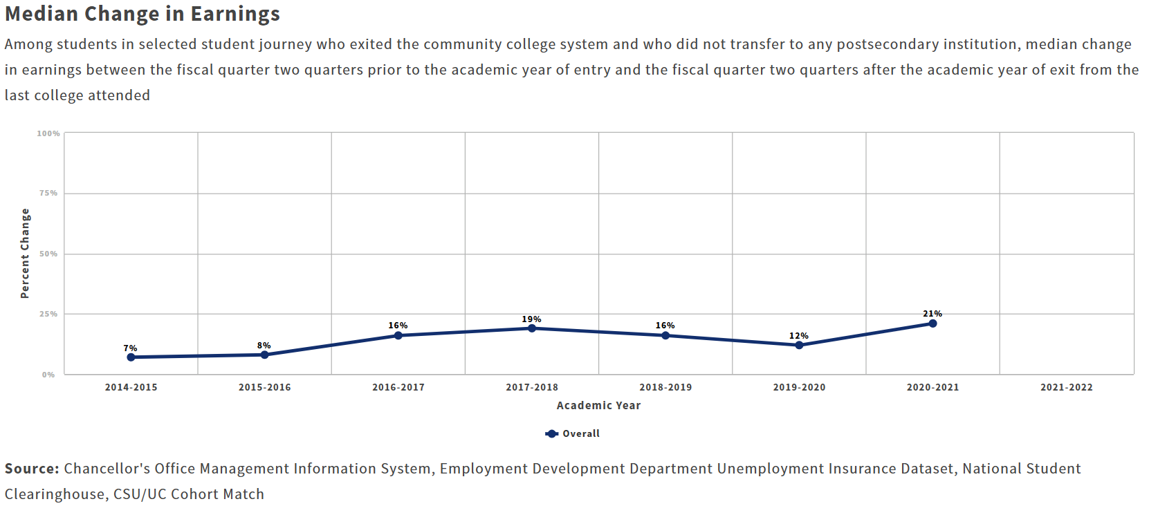
LaunchBoard: Short-Term CTE (primarily Westec campus)
Short-Term CTE students see an increase in earnings after finishing their coursework and training
Taft College Short-Term CTE students (primarily attending the Westec campus) see higher gains than the region or state
Disaggregation by ethnicity and gender is not available

Slide 47
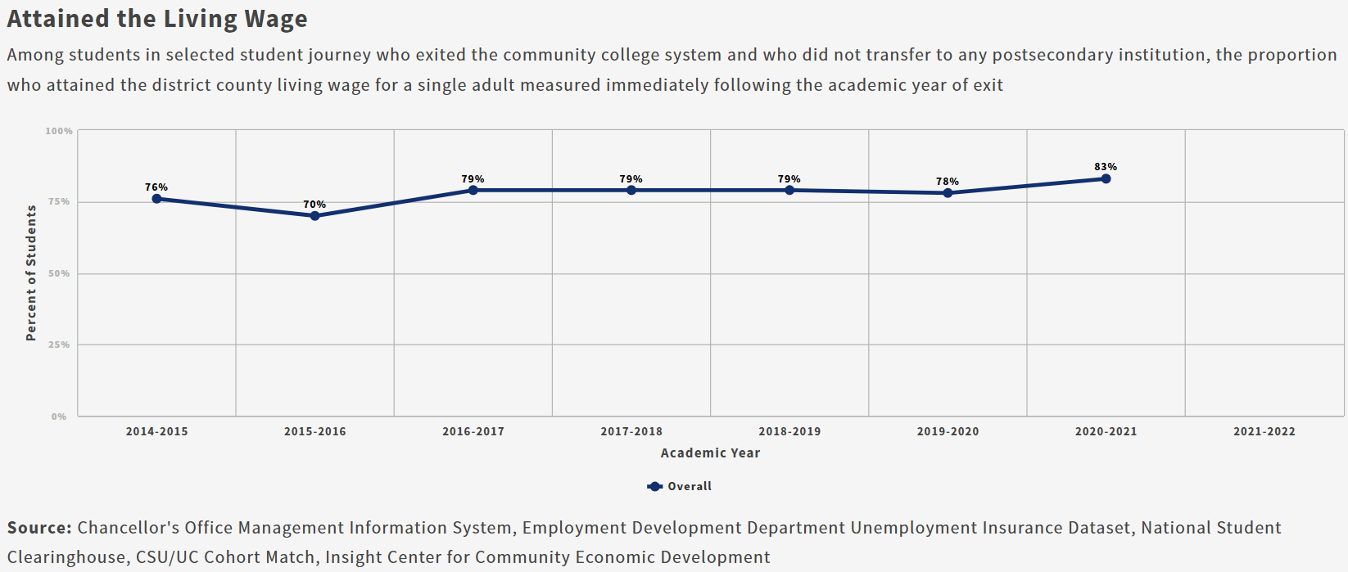
LaunchBoard: Short-Term CTE (primarily Westec campus)
Taft College Short-Term CTE students see an increase in earnings after finishing their coursework and training
Taft College Short-Term CTE students see higher gains than the region or state
Disaggregation by ethnicity and gender is not available

Slide 48
Thoughts?

Slide 49
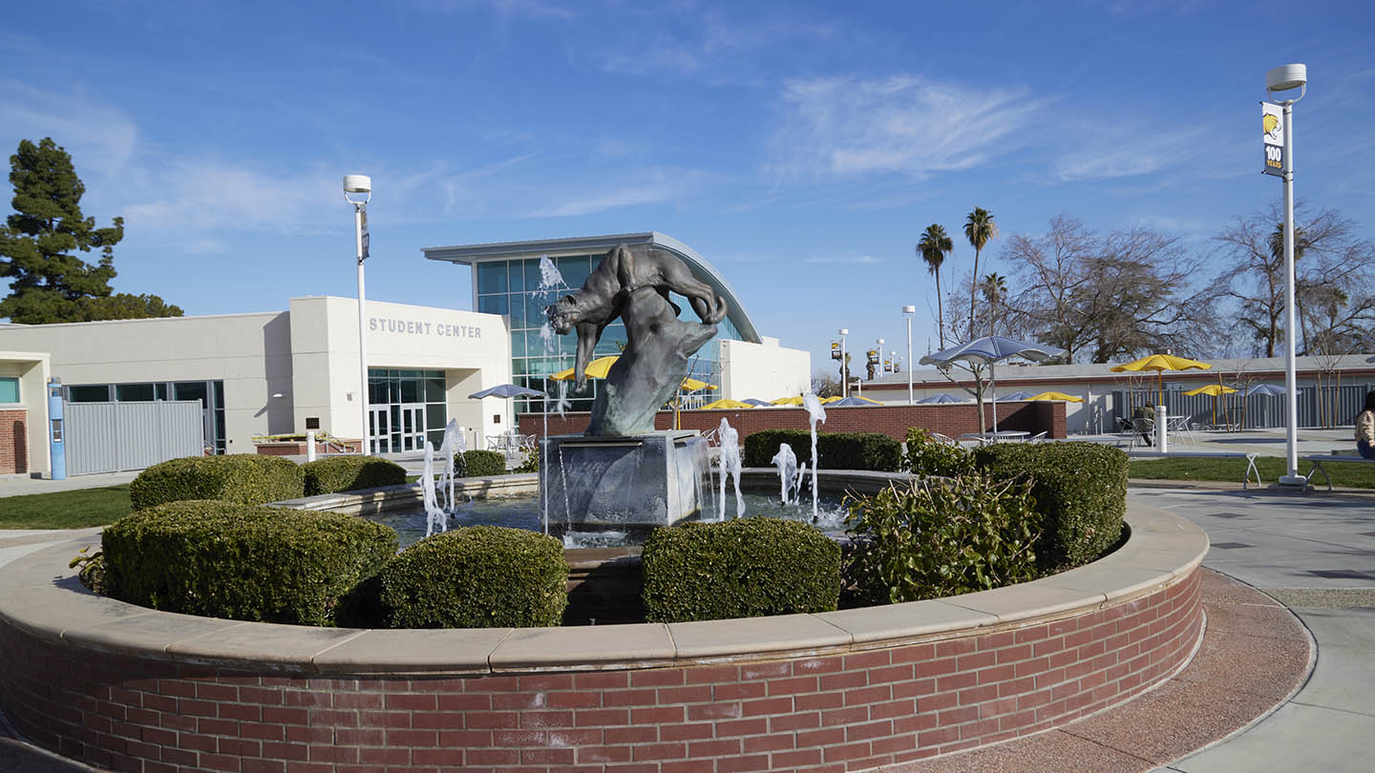
Taft Degree/Transfer Students

Slide 50
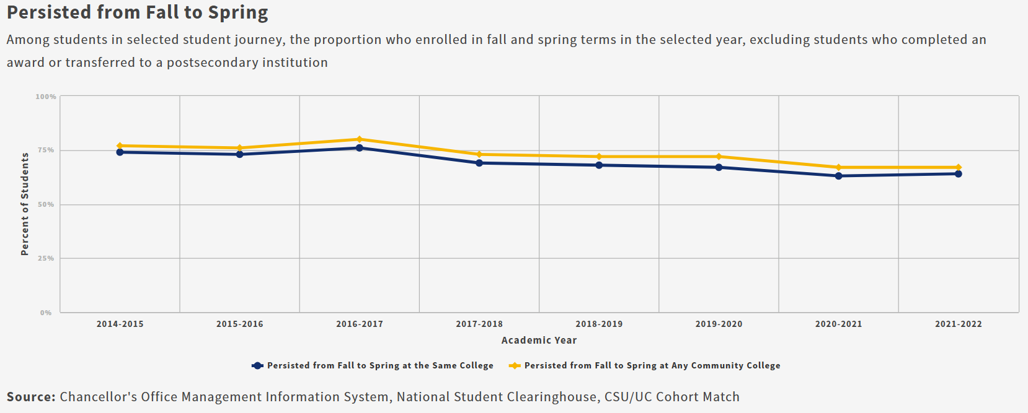
LaunchBoard: Degree/Transfer (primarily Taft campus/online)
Taft College fall to spring persistence rates have hovered between 64% and 86% in recent years, and are lower than the region and the state

Slide 51
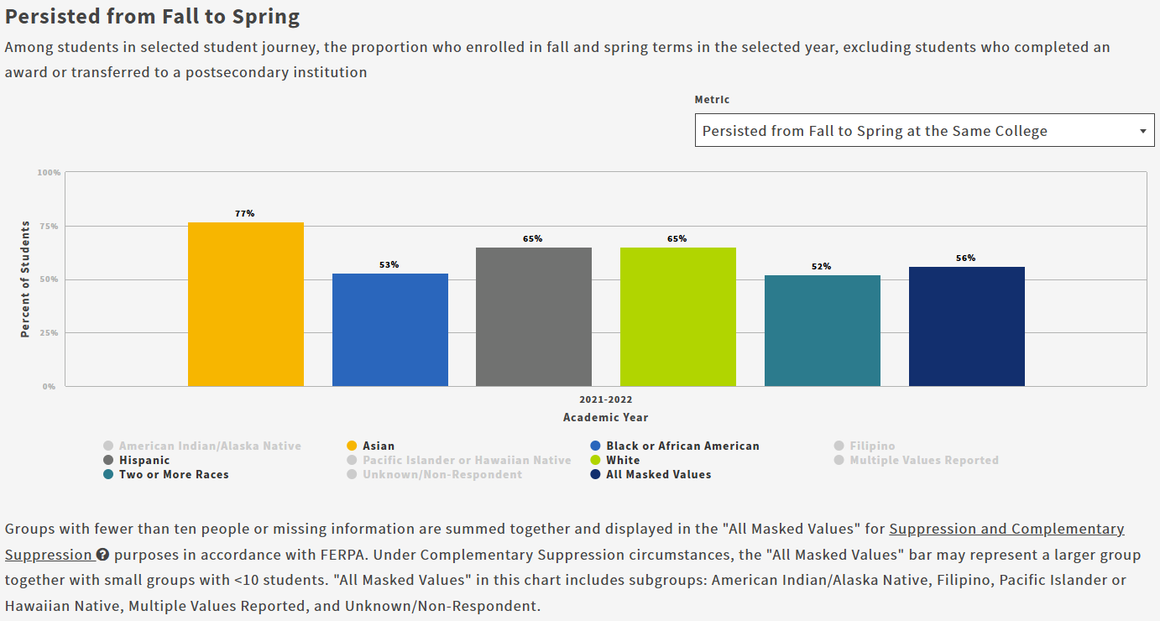
LaunchBoard: Degree/Transfer (primarily Taft campus/online)
Asian students have the highest persistence rate (77%), followed by Hispanic (65%) and White (65%), and Black (53%) -- note 24% gap between high and low
Female students have higher persistence rates (66%) than male students (61%)

Slide 52
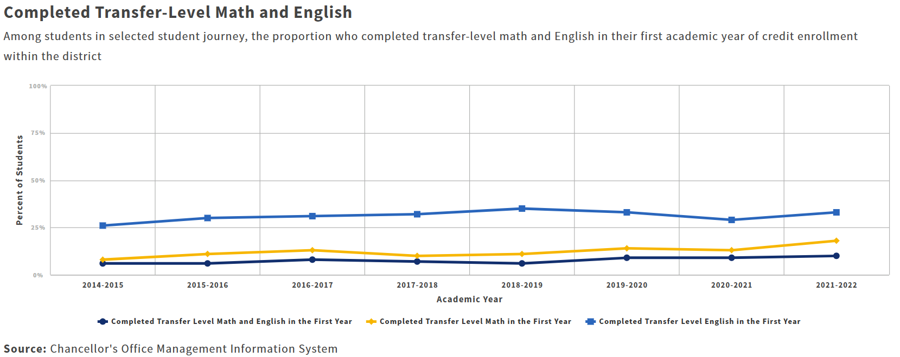
LaunchBoard: Degree/Transfer (primarily Taft campus/online)
The percentage of Taft Degree/Transfer students completing transfer level math, English, and both has generally increased over the past five years, with a slight dip in 2020-21, but is still lower than regional and state rates

Slide 53
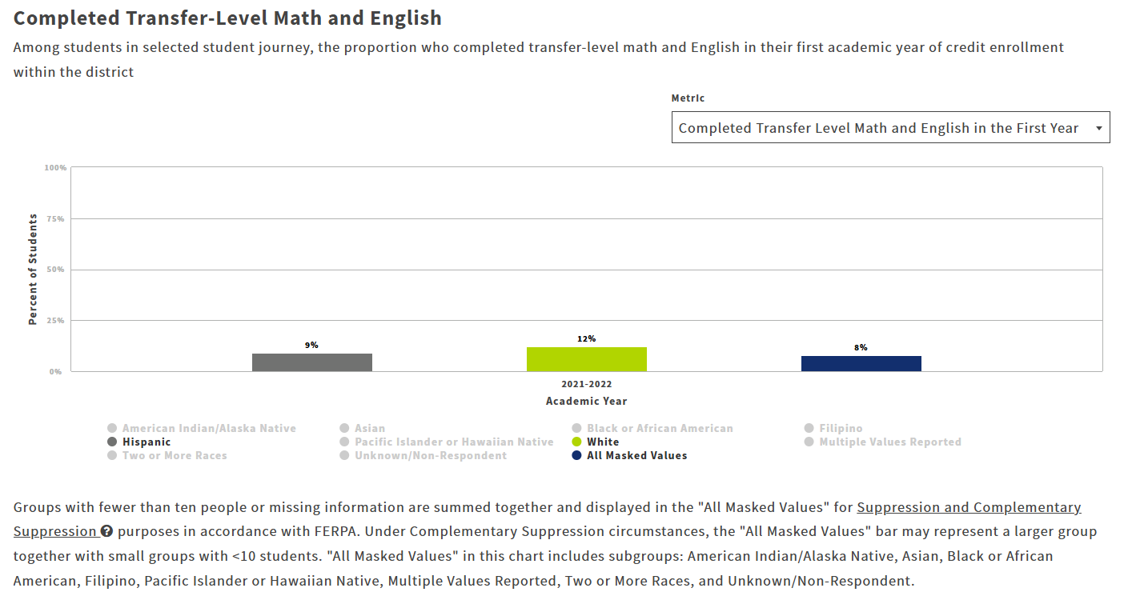
LaunchBoard: Degree/Transfer (primarily Taft campus/online)
n/a
12% of White students and 9% of Latino students completed Transfer level Math and English in the first year
Data for male students was not available

Slide 54
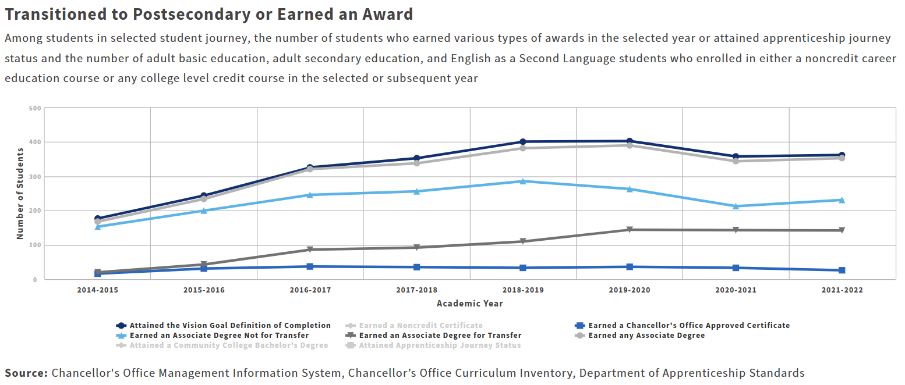
LaunchBoard: Degree/Transfer (primarily Taft campus/online)
Completion rates have generally trended upward for Taft students over the past years, but dipped in 2020-21
Taft College completion rates are higher than the region or state
The majority of Degree/Transfer students who complete do so by earning a degree, with most of those earning an “Associate Degree Not for Transfer”

Slide 55
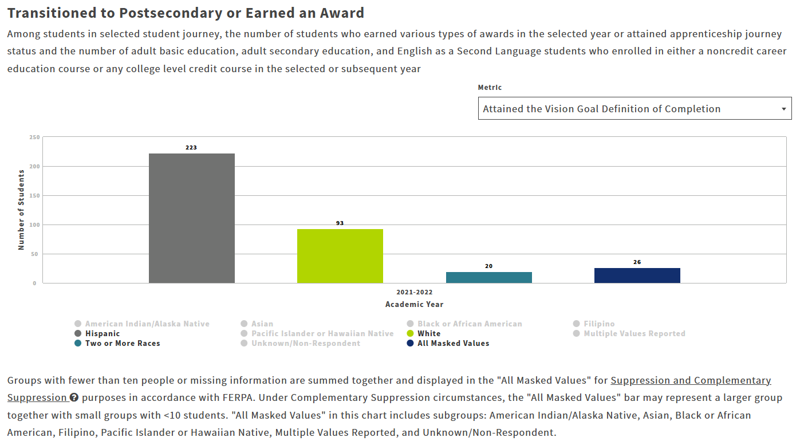
LaunchBoard: Degree/Transfer (primarily Taft campus/online)
This chart (above left) shows volume only, but the source document shows rates: 16% of Latino and 14% of White students attain the Vision Goal for Completion
A higher percentage of females (17%) attain vision goal completion than males (13%)

Slide 56
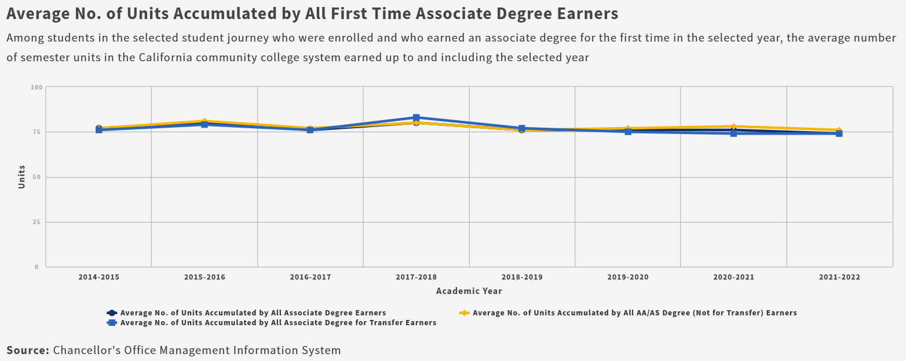
LaunchBoard: Degree/Transfer (primarily Taft campus/online)
Average units at degree completion is lower at Taft than in the region or statewide

Slide 57
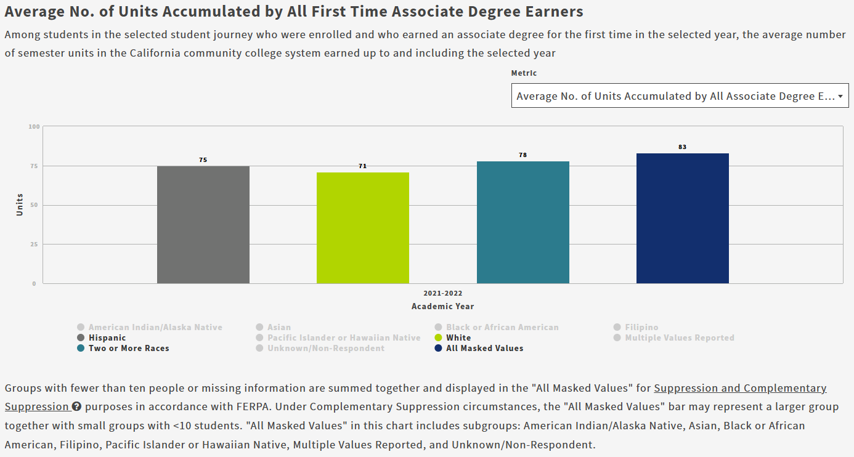
LaunchBoard: Degree/Transfer (primarily Taft campus/online)
Whites and males graduate more efficiently, with 71 units on average, while Latino and female students accumulate more units

Slide 58
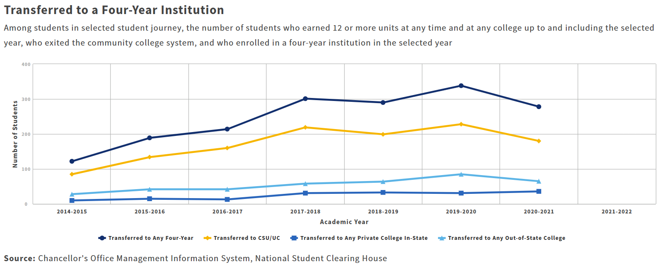
LaunchBoard: Degree/Transfer (primarily Taft campus/online)
The overall proportion of Taft students transferring to 4-year institutions increased over past years, then decreased in 2020-21
Disaggregation by ethnicity and gender is not available
The percentage of students transferring from Taft is slightly lower than the regional or state averages

Slide 59
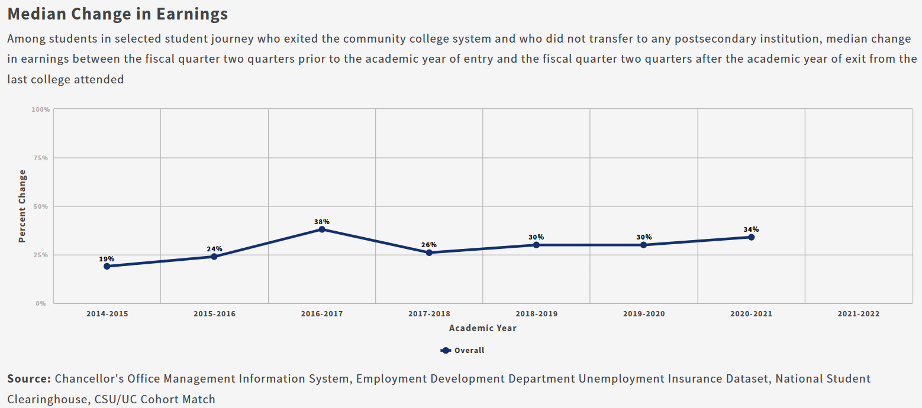
LaunchBoard: Degree/Transfer (primarily Taft campus/online)
The median change in earnings for Degree/Transfer students who did not transfer has increased over the past years, and is higher than the statewide average (but lower than the region)
Disaggregation by ethnicity and gender is not available

Slide 60
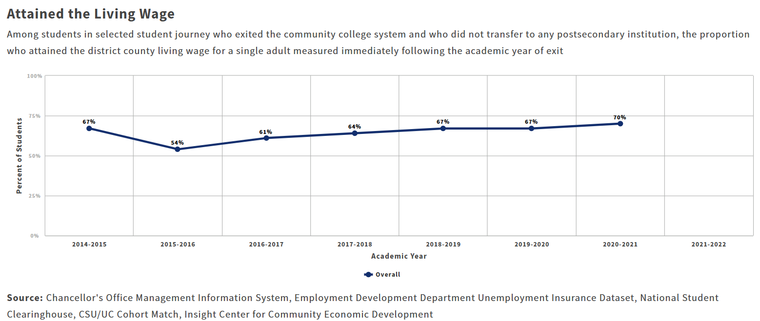
LaunchBoard: Degree/Transfer (primarily Taft campus/online)
The proportion of Taft students who do not transfer attaining the regional (county) living wage has trended upward in past years, and is higher than the region or statewide proportion of exiting students earning the living wage
Disaggregation by Ethnicity and Gender is not available

Slide 61
Thoughts?

Slide 62
Listening Session Themes
Internal and External stakeholders and Students
17 Stakeholder Listening Sessions
100 Individual participants

Slide 63
Six Themes
Enhancing the Student Experience and Resources
Educational Programs and Support
Organizational Culture and Communication
Community Engagement and Partnerships
Diversity, Equity, Inclusion, Accessibility, and Anti-Racism
Institutional Effectiveness, Infrastructure, and Resource Management

Slide 64
Enhancing the Student Experience and Resources
Student Experience
Personal connection between faculty, staff, and students
Small size, welcoming atmosphere, and easy campus navigation are attractive to students
Faculty-to-student solid relationships are a key factor in drawing students to the College
Students prefer Taft due to better course scheduling, flexible day courses, increased financial
aid, and more personalized support
Small class sizes foster close relationships between students and instructors.
Direct access to faculty and staff enhances students’ experiences

Slide 65
Enhancing the Student Experience and Resources
Enrollment and Retention
Challenges include declining enrollment and student retention
Increase focus on persistence/retention/completion with redesign and relaunch of Guided Pathways, use of learning communities, and enhanced First Year Experience (FYE)
Implement well-designed Strategic Enrollment Management Plan (SEM) that includes student-centered approach to scheduling, programming, courses, and services
Increase responsiveness to student needs, especially among Latino students
Ensure Taft programs are well-known and continuously marketed

Slide 66
Enhancing the Student Experience and Resources
Academic Counseling
Students desire initial orientation and career exploration events
Increase consistency among counselors to ensure students’ educational plans are not altered multiple times
Concern among students that general education classes will not fulfill university requirements
Students desire exploration of non-traditional career paths that suit their needs instead of only being directed to a transfer degree

Slide 67
Enhancing the Student Experience and Resources
Student Engagement
Many students unaware of available orientation since it is not mandatory
Need to fund student affinity groups
Designated student spaces needed on campus for events, meetings, and organizations
Increase efforts to recognize and honor Taft’s designation as a Hispanic Serving Institution (HSI)

Slide 68
Enhancing the Student Experience and Resources
Student Resources
Ensure students are aware of available institutional resources
Concerns regarding mental health services include lack of access to counselors and adequate care
Student transportation to campus is an issue
Childcare Center services unavailable for Taft students
Dedicated Career Services Center is needed for students
Spanish tutoring is currently unavailable

Slide 69
Educational Programs and Support
Scheduling
Need for innovative, student-focused class schedules that are flexible and include balanced mix of delivery methods
Achieve an optimal balance between online and in-person classes for economic viability
Lack of a wide variety of available courses impacts the scheduling flexibility for student athletes
Consider implementation of a technology solution to improve class scheduling and classroom efficiency

Slide 70
Educational Programs and Support
Career/Guided Pathways
Employees and students have limited understanding of Taft Pathways
Implementation of Guided Pathways at scale is lacking and requires attention
Comprehensive redesign and reset of Guided Pathways, led by the Vice Presidents of Instruction and Student Services, should ensure alignment with a variety of majors and be closely aligned with California’s Vision 2030

Slide 71
Educational Programs and Support
Educational Offerings
Expressed need for ESL (credit/noncredit) and support services for non-English speakers
Explore opportunities for Continuing Education (noncredit) offerings, especially workforce training programs/courses
Assess and expand contract training offerings
Further expand apprenticeship opportunities
Financial literacy and information literacy training needed
Recognize and address the future impact of Generative Artificial Intelligence (AI) on future students and employees

Slide 72
Educational Programs and Support
Program Review and Opportunities
Determine vitality and relevance of current instructional programs and plan, design, and develop new programs to meet regional workforce needs (credit, non-credit, and dual enrollment)
Need short-term training opportunities for incumbent employee upskilling as well as entry-level positions
Consider opportunities to pursue CTE programs in collaboration with high school offerings (e.g., culinary/hospitality)
Increase opportunities for Credit for Prior Learning

Slide 73
Educational Programs and Support
Online Learning
Assess technology challenges and faculty professional development needs for hyflex instruction
Further expand online tools to assist students with classes and stay competitive (tutoring, learning tools, access, etc.)
Increase online courses that are badged by the California Virtual College (CVC) to be competitive with virtual learning offerings at other colleges

Slide 74
Educational Programs and Support
Student Support
Online Education Resources and Zero Cost Textbooks need to be prioritized and sustained for the future
Offer more cross-disciplinary collaborative learning opportunities
Upgrade and expand plagiarism and proctoring services
Provide faculty professional development activities to increase understanding of today’s students (e.g. apprenticeships/internships, pathways information, career trips)
Consider development and implementation of course evaluation processes to improve instruction and support faculty professional development

Slide 75
Diversity, Equity, Inclusion, Accessibility, and Anti-Racism (DEIAA)
Increase institutional commitment to DEIAA through continuation of DEIAA Committee’s work and recommendations
Initial and ongoing DEIAA training needed for employees and students
Continue advocacy for employment of a DEIAA staff member
Respond to concerns of marginalized students and diversity faculty to reflect changing student population
Address accessibility issues through the implementation of TC’s accessibility plan for the campus

Slide 76
Community Engagement and Partnerships
Community Engagement
Heighten responsiveness to current and future community needs
Focus on the service area boundaries of the college and the services it offers
Enrich partnerships with the Chamber of Commerce and community to form and expand partnerships with businesses and industries
Enhance community relationships and outreach opportunities to increase understanding of Taft College, its services, and being an asset to the region

Slide 77
Community Engagement and Partnerships
Community Engagement
Develop/expand partnerships with tribal nation (e.g., Tejon)
Continue collaboration with the local and regional economic development groups
Expand affiliations with trade unions and local industries to create certificate and apprenticeship opportunities

Slide 78
Community Engagement and Partnerships
Educational Partnerships
Improve connection with universities to maintain current transfer degree plans for students
Strengthen the pipeline and create seamless pathways between Taft College and High Schools as part of Guided Pathways
Continue to expand dual enrollment partnerships and offerings, including Career and Technical Education (CTE) programs
Enhance partnerships with universities to create teacher pathways for the first two years
Increase Early Childhood Education program internships

Slide 79
Organizational Culture and Communication
Culture
Continue to enhance and maintain Taft’s culture by emphasizing what makes it special
Create a long-range staffing plan to forecast future needs
Further invest in employee success and advancement through the creation and implementation of initial onboarding
Enhance professional development structure and expectations for employees
Increase collaboration across institutional departments to avoid working in silos
Strive for consistency in institutional leadership

Slide 80
Organizational Culture and Communication
Communication and Marketing
Develop well-defined marketing plan to engage with students and community members
Create a crisis communication plan
Increase targeted marketing for instructional programs
Utilize technology solutions (e.g., Salesforce) to improve efficiency after addressing limited departmental staffing

Slide 81
Institutional Effectiveness, Infrastructure, and Resource Management
Institutional Effectiveness
Administrators, faculty, and staff need access to current comprehensive data and engage in professional development to better understand and analyze the data in order to make data-informed decisions
Faculty need to understand data, know how to determine the most important priorities and make the best decisions
Assess the adequacy of staffing in the Institutional Research and Planning department

Slide 82
Institutional Effectiveness, Infrastructure, and Resource Management
Facilities
Assess the condition of college facilities, determine utilization efficiency, and establish priorities to meet current and future student needs
Need comprehensive assessment of the total cost of ownership for all current and future campus buildings to make informed resource decisions
Acquire enhanced technology resources and tools for online/digital learning and technology solutions to increase organizational efficiency
Access potential use for dormitories during the summer since they have historically been closed

Slide 83
Institutional Effectiveness, Infrastructure, and Resource Management
Fiscal Resources
Lack of a dedicated grant writer, although numerous grant opportunities and awards, such as HSI grants, could be pursued
Consider applying for grants and form partnerships (e.g., CSUB, Alan Hancock, College of Canyons) in renewable energy (e.g., Carbon Capture, EV, Hydrogen)
Taft College has been designated as a Hispanic-Serving Institution (HSI) since 2005 and should take greater advantage of the benefits

Slide 84
Challenges and Opportunities

Slide 85
Challenges
What are the most significant challenges
Taft College faces for the next ten years?

Slide 86
Opportunities
What are the greatest opportunities
for Taft College in the next ten years?

Slide 87
Next Steps
10/21: CBT Team synthesizes Challenges and Opportunities; adds to EMP draft
10/22: Draft EMP Document distributed to members for review and feedback
11/4: All suggested edits due to Xiaohong for compilation and approval
11/7: Xiaohong sends College-approved edits to CBT
11/14 (1-4) & 15 (10-1): CBT-facilitated Goal-Setting session
11/22: CBT submits Final Draft EMP to Taft College; Project completes
-----------------------------------------------------------------------------------------------------------
11/25: Governance review and approval processes begin

Slide 88
Closing Remarks
Co-chairs & College president

