Slide 1
Purchase Order Process
An Overview Training Guide

Slide 2
Steps to proper Purchase Order Approval
Step 1
End User / Department initiates Purchase Request in Banner
Step 2
Appropriate Approvals are Obtained & Purchase Order is finalized.
Step 3
Step 4
End User/Department acts as receiving department & verifies delivered goods.
Vendor is contacted to order supplies and is supplied the approved PO #.

Slide 3
Steps to proper Purchase Order Approval
Step 5
Invoice is sent to Accounts Payable for processing and AP will contact the end user to confirm the purchase.
Step 6
Accounts Payable submits request for payment of invoice county for processing.
Step 7
Step 8
Checks are sent to the mailing instructions on the PO to pay vendor.
County audits A/P batches & generates vendor checks.

Slide 4
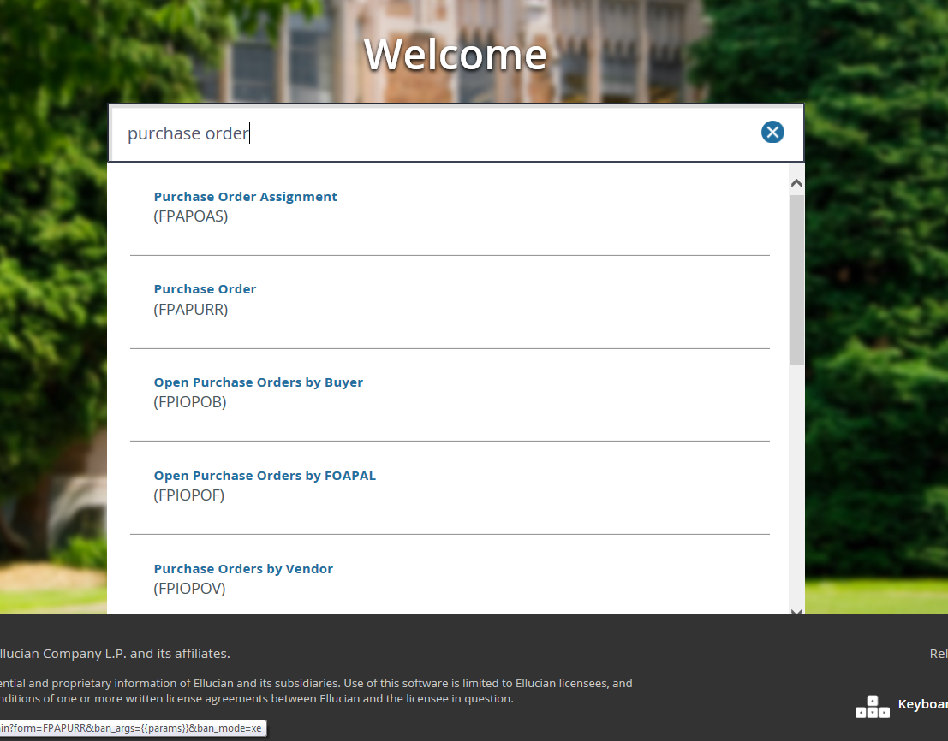

Slide 5
Order Type: Regular or Standing (Standing for Open PO’s) Delivery Date: Same date as Order and Transaction Date Comments: Details about your PO Document Level Accounting: Uncheck if you would like to use different account codes in the Commodity/Accounting tab. You should always default to an unchecked box. Buyer Code: TAFT

Slide 6
Requestor: Employee requesting PO Organization: Org Code Ship To: CMPUS Attention To: Employee requesting PO

Slide 7
Vendor Look Up
Verify that the vendor you are using is set up in Banner. (FTIIDEN)
If vendor is not set up, contact the Cashier’s Office to have the vendor established.

Slide 8
Taxable Items
Can you see, touch or hold the item being purchased?
No, It is a probably a service provided & non-taxable
Yes
Can you eat or drink the item?
No, then it is taxable.
Yes, the item is non-taxable.

Slide 9
Scenario Taxable Items
Soda
CRV
You can hold the item.
You can drink the item.
Item is not taxable
Shelf
You can hold the item.
You do not eat the item.
Item is taxable
You can not see the item
Item is not taxable

Slide 10
Vendor: Enter Vendor A number Address Type: BU or MA (you can click on the 3 dots to ensure it is listing the correct address) Address Sequence: Enter the correct address sequence that corresponds with the correct address Tax Group: TFT2 or EXMT

Slide 11
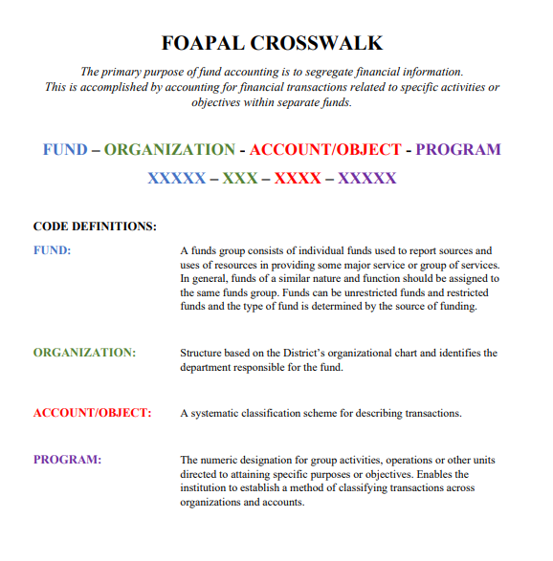
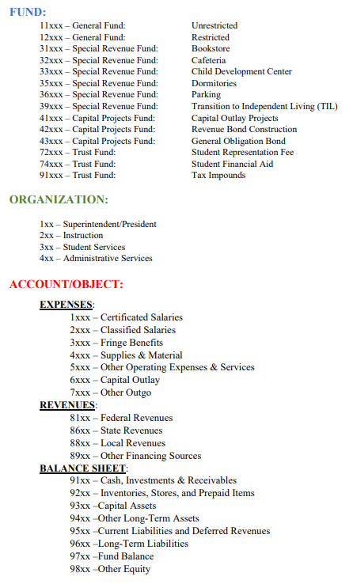
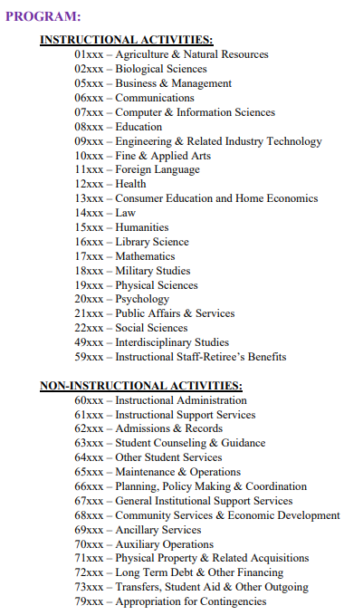
Accounting Structure

Slide 12
Scenario Accounting Structure
11000
421
5710
67200
Business Services
Unrestricted General Funds
Business Services Approval Path
Employee Travel

Slide 13
Commodity: Enter Description, U/M, Tax Group, Quantity, Unit Price Check Document Level Accounting: Checked box (will not separate account codes for each item in commodity) Unchecked box (will separate account codes for each item in commodity) Accounting: Enter FOAP for each item

Slide 14
Complete: Submit for approvals In Process: Will not submit for approvals

Slide 15
Cancelling a Purchase Order
Has an invoice been paid against the PO?
Yes, Contact Accounts Payable to cancel.
No
Has the PO been approved by all approvers?
No, Contact next approver to deny PO back to you or you can deny in Banner Screen: FOADOCU
Yes, Cancel PO using Banner Screen: FPAPDEL

Slide 16
Banner Codes for Purchase Orders

Slide 17
Questions? Comments?
We are happy to help you!

